Slide 1
Structures In A Geometric World
A Teacher In Action Project: Engineering Design Process: Using an Integrated Approach to implement Scientific Inquiry to enhance motivation in the primary classroom.
By Colleen Power (Grade 3) And Florrie Reid (Grade 2)
Holy Family Elementary School - Chapel Arm (2015-16)

Slide 2
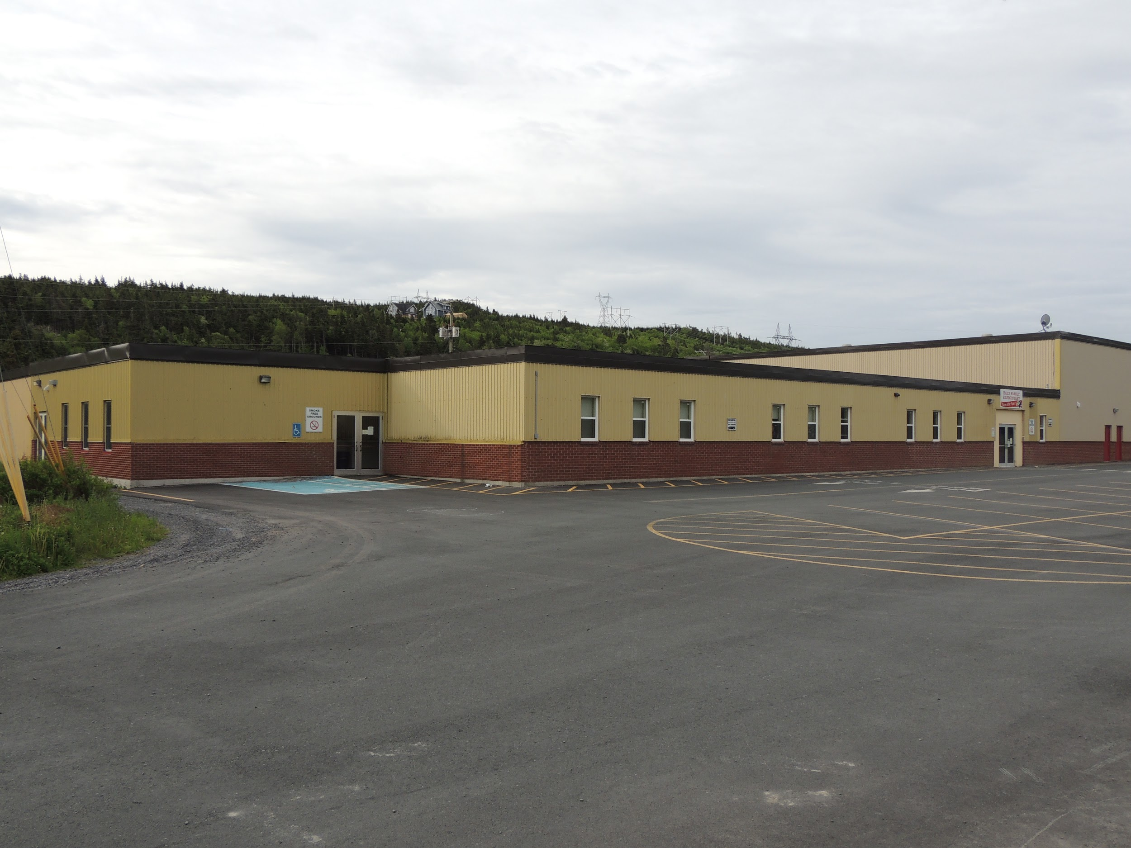
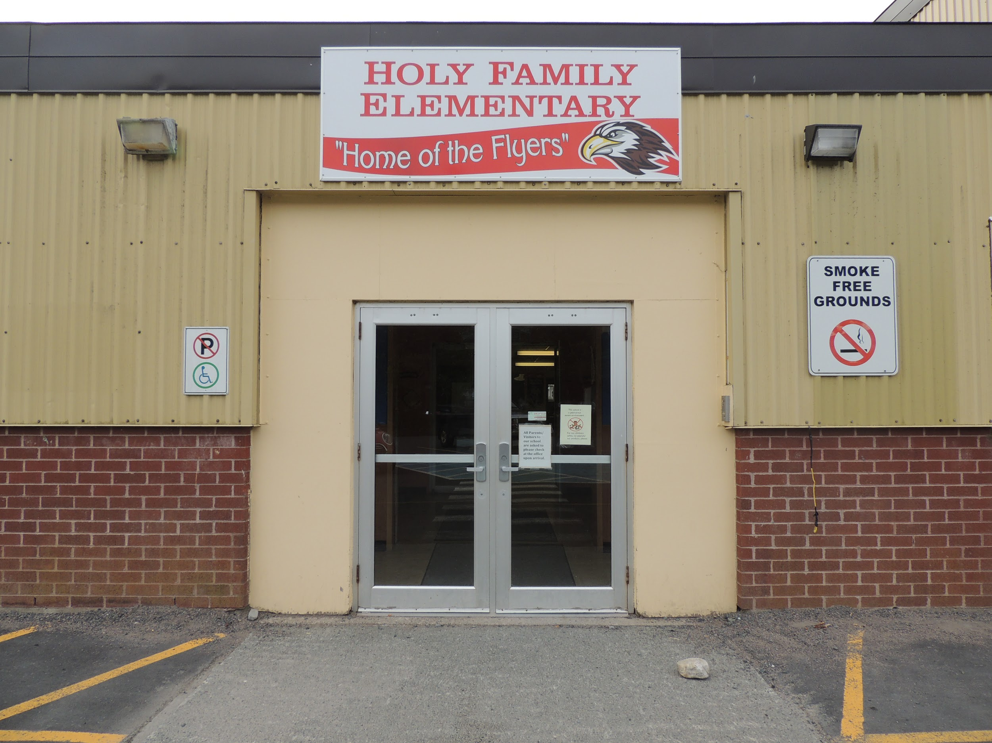
Holy Family Elementary School is a K-6 school with 103 students. We are nestled in the beautiful community of Chapel Arm with 8 other communities feeding into our population.
BACKGROUND INFORMATION
Our School

Slide 3
Team Members
Colleen Power has been teaching for 28 years in the Primary Classroom. She is currently teaching grade 3 with 13 students - 11 girls and 2 boys.
All children have the ability to learn at their own pace. I believe my role is to be a resource in the classroom to help students reach their full potential academically and socially.
Teaching for me is not just about teaching but also about learning so that all students feel valued and safe. This then helps them learn about their full potential and be excited about reaching it.

Slide 4
Team Members
Team Members
Florrie Reid has been teaching for 18 years in the Primary Classroom. She is currently teaching grade 2 with 17 students - 8 girls and 9 boys.
I am passionate about learning. I am a global learner, kinesthetic and visual learner. I like structure but I am flexible...I live for teachable moments. I believe ALL children can succeed. I believe teachers are facilitators. I have always loved science and hands on learning. I love teaching in a student centered environment.

Slide 5
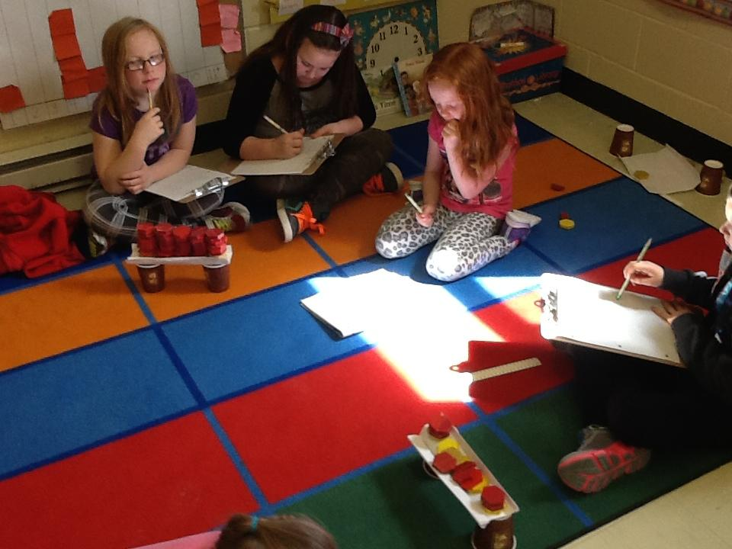
Focus Area
We wanted to engage and motivate students in their learning. We wanted to improve our teaching in the area of EDP (engineering and design process) and SI (scientific inquiry) through a cross-curricular approach. We used our Curriculum Outcomes for:
Science structures and matter
Math outcomes in geometry, measurement, problem solving, estimation, data analysis.
Technology outcomes
Language Arts outcomes in communication in oral and written language, comprehension strategies-analyzing, inferencing and synthesizing
Online resources we used were: Scientist in Residence Program, Science and Children, Bricks for kidz and Class Dojo
Science
Math
Engineering Design Process (EDP)
Scientific Inquiry (SI)
Notes:
Overlapping outcomes

Slide 6
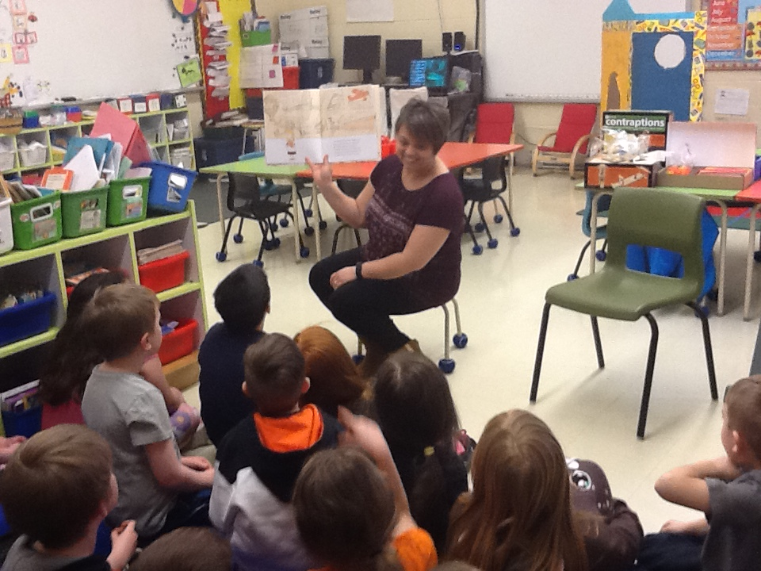
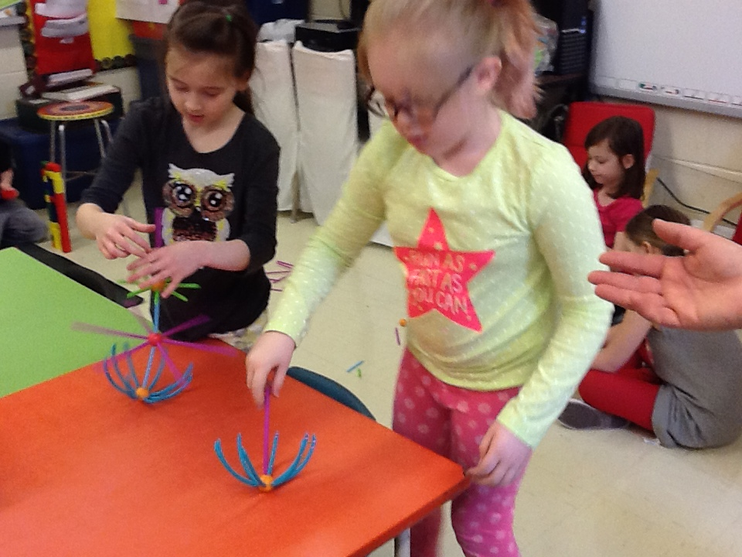
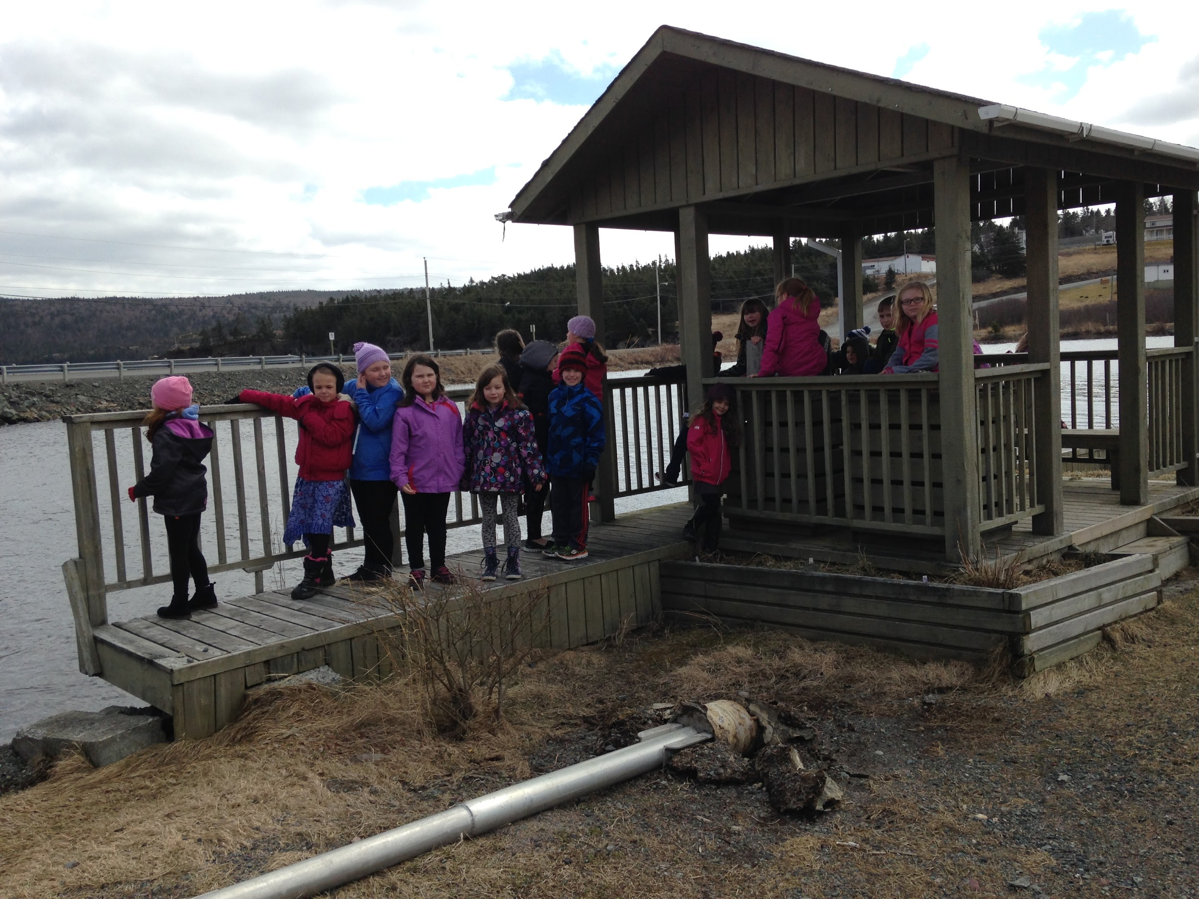
Research Questions
Student Question: How can we use an integrated approach to implement the Engineering Design Process (EDP) and Scientific Inquiry (SI) to enhance motivation and engagement?
Teacher Questions: What is our role in implementing the EDP and SI in our classroom? What is EDP? What is SI?
Notes:
We measured motivation and engagement

Slide 7
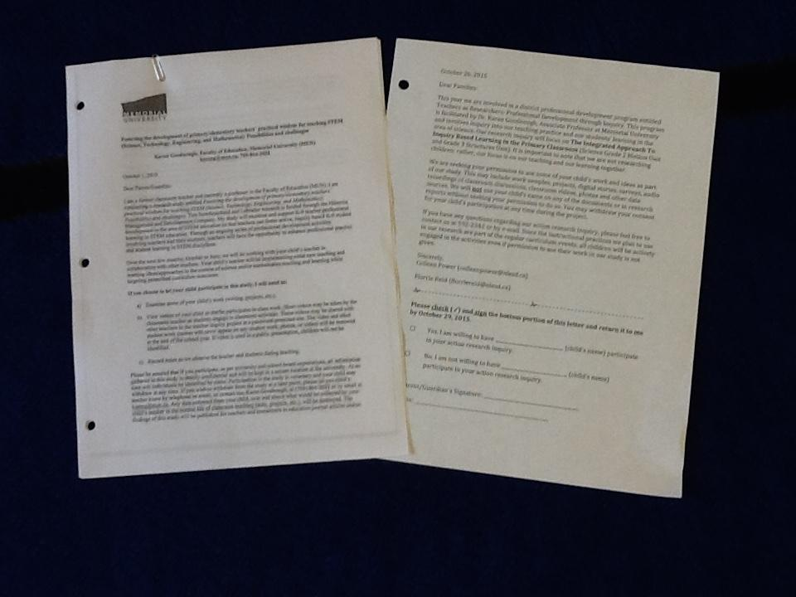
Ethical Considerations
We sent two forms home to the families informing them of the project. One form was from our school Holy Family Elementary and the other was from Memorial University of Newfoundland.

Slide 8
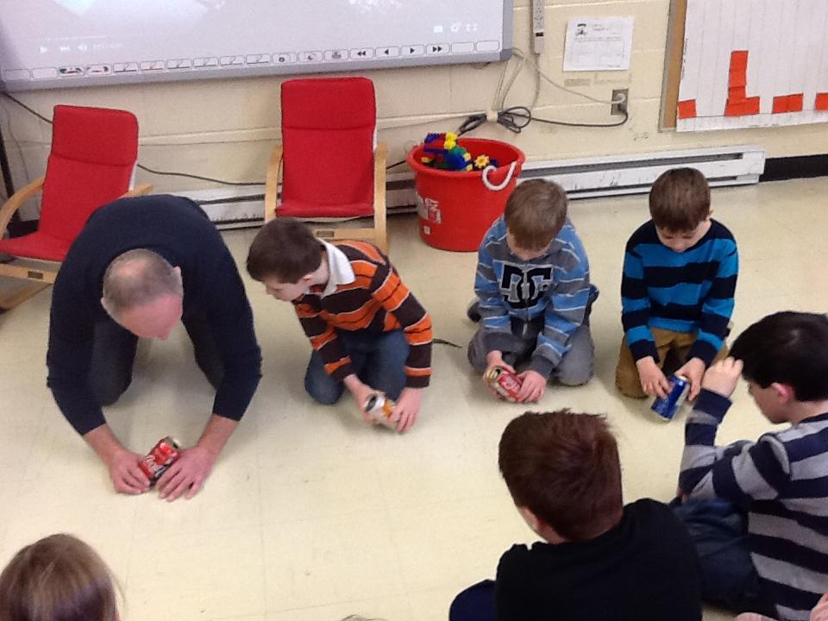
Planning
Attended a two day institute held in August at MUN with other TIA participants
We had four meetings with Tom Walsh from September to January to discuss our planning and to observe him teaching our students using the 5E Model.
We also met several times to collaborate on ideas, plan our lessons and activities, and prepare and gather materials.
Students and teachers used journals to records thoughts, designs and results from projects.

Slide 9
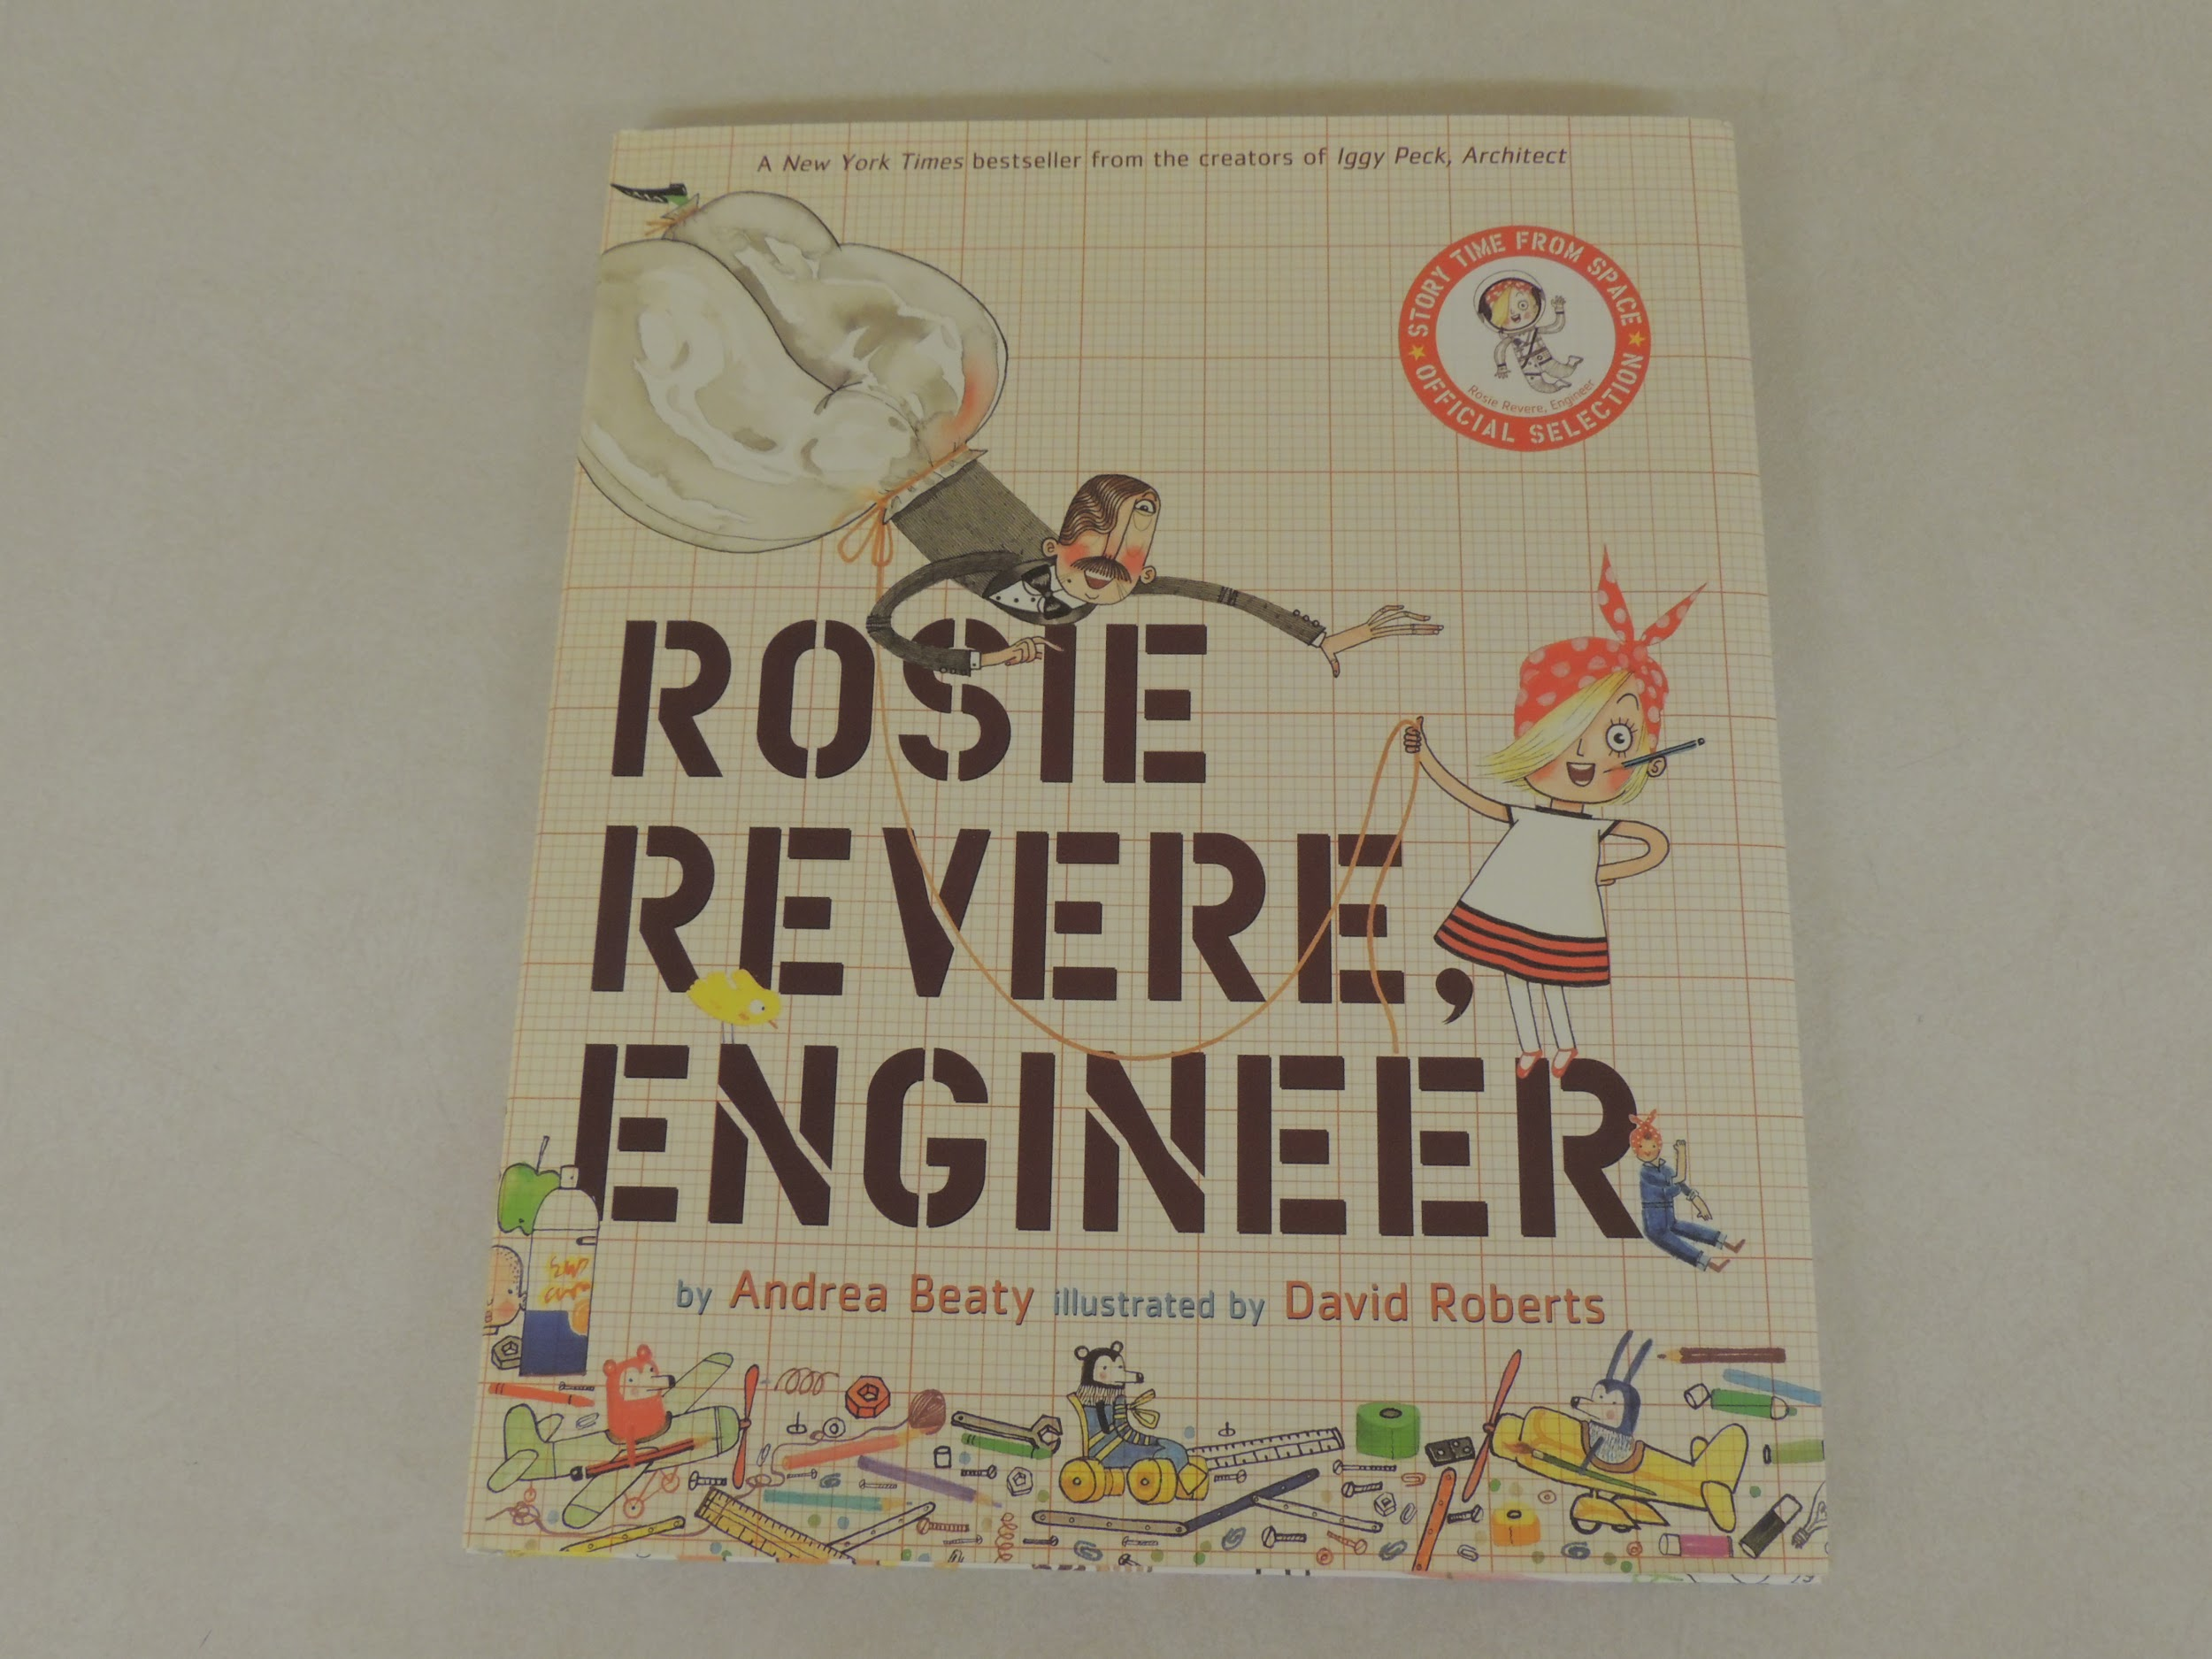
Planning
We used literature to guide our planning:
The Science And Children Magazine helped us with our research in the EDP-5E Model and SI.
We referred to online lessons from The Scientists In Residence Program.
The Pan Canadian Science Place ‘Build It Up’ unit
The ‘How Did They Build That?’ series by the Saunders Book Company
‘Engineering In Our Everyday Lives’ by Reagan Miller
‘Rosie Revere Engineer’ by Andrea Beaty
‘What Am I ?’ and ‘Shaping Up’ by Pearson Education Canada
‘The Little Red House’ by Norma Jean Sawicki

Slide 10
Constructivist Learning Theory- construct meaning & knowledge from our experiences
Inquiry based Learning- open ended, student centered & hands on activities
EDP-5E-all 5 E’s work together to help the learner pay attention to HOW they learn- METACOGNITION
EDP-5E MODEL
EXPLAIN &/ ENGINEER
Teacher facilitates. Learner develops explanation or engineers the concept
EXPLORE
Exploring concept(s)
ELABORATE
Learner applies what is learned...may modify or improve ideas
In EVERY lesson we facilitated, this was the guiding force behind it!
ENGAGE
Getting learners excited
EVALUATE
Not just about teacher assessment. Mostly about learners evaluating their own understanding

Slide 11
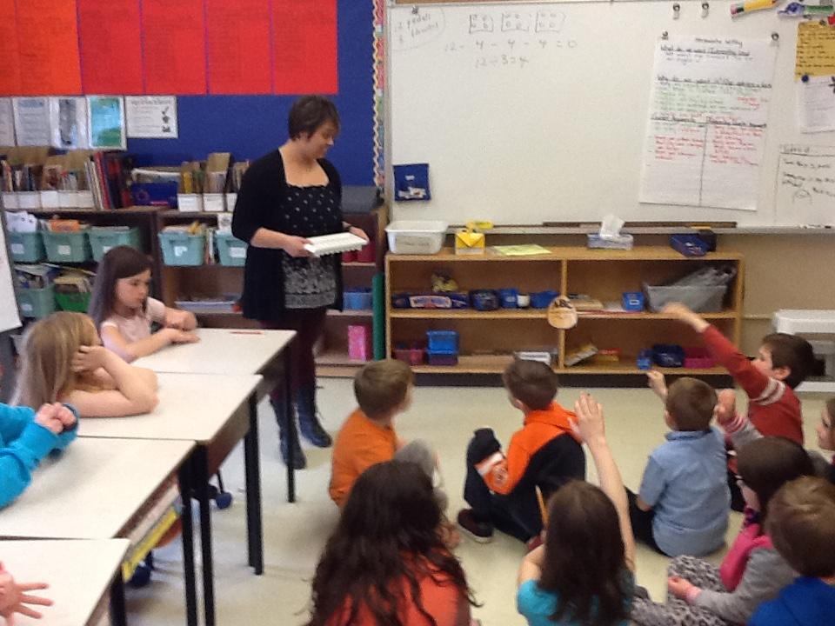
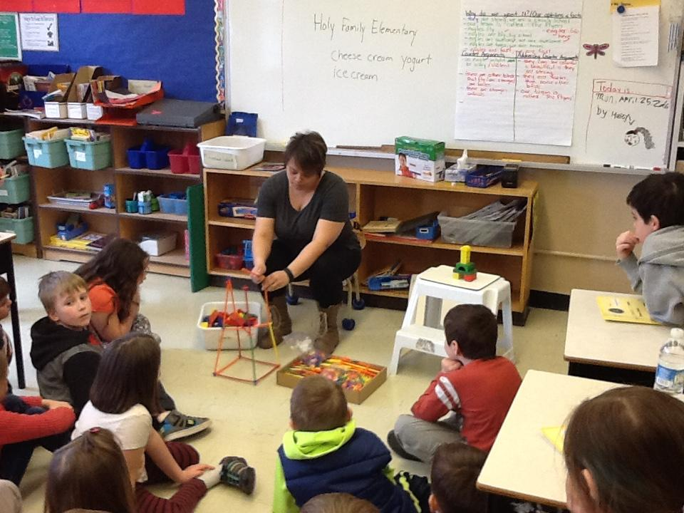
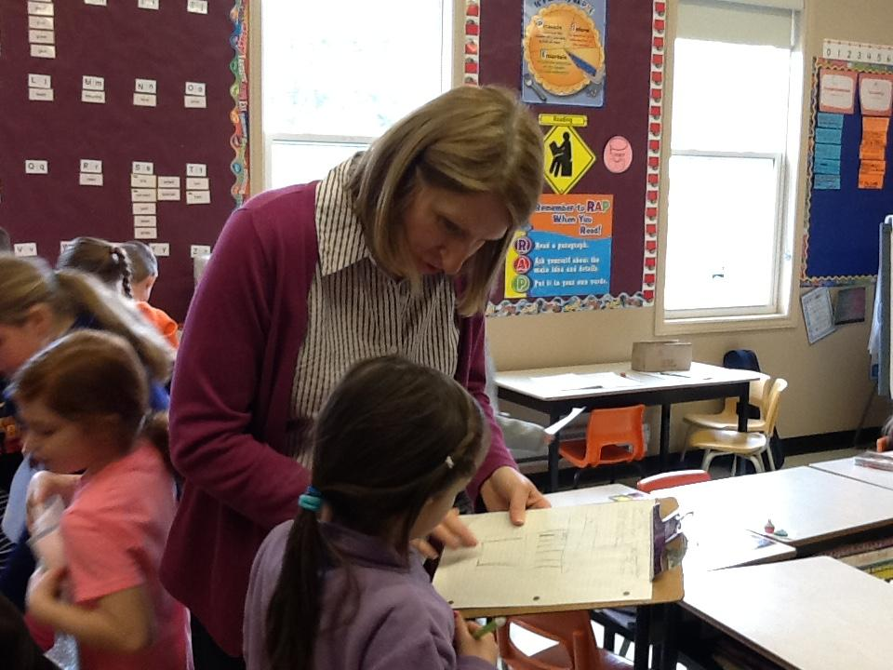
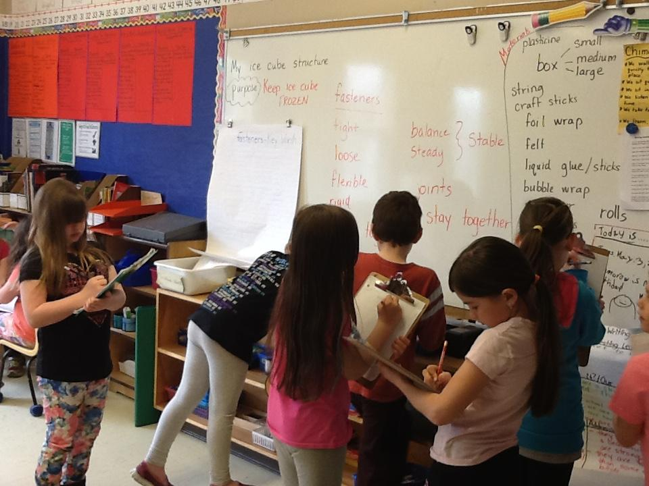
Implementation
ENGAGE
Getting learners excited
Many large group and small group discussions!

Slide 12
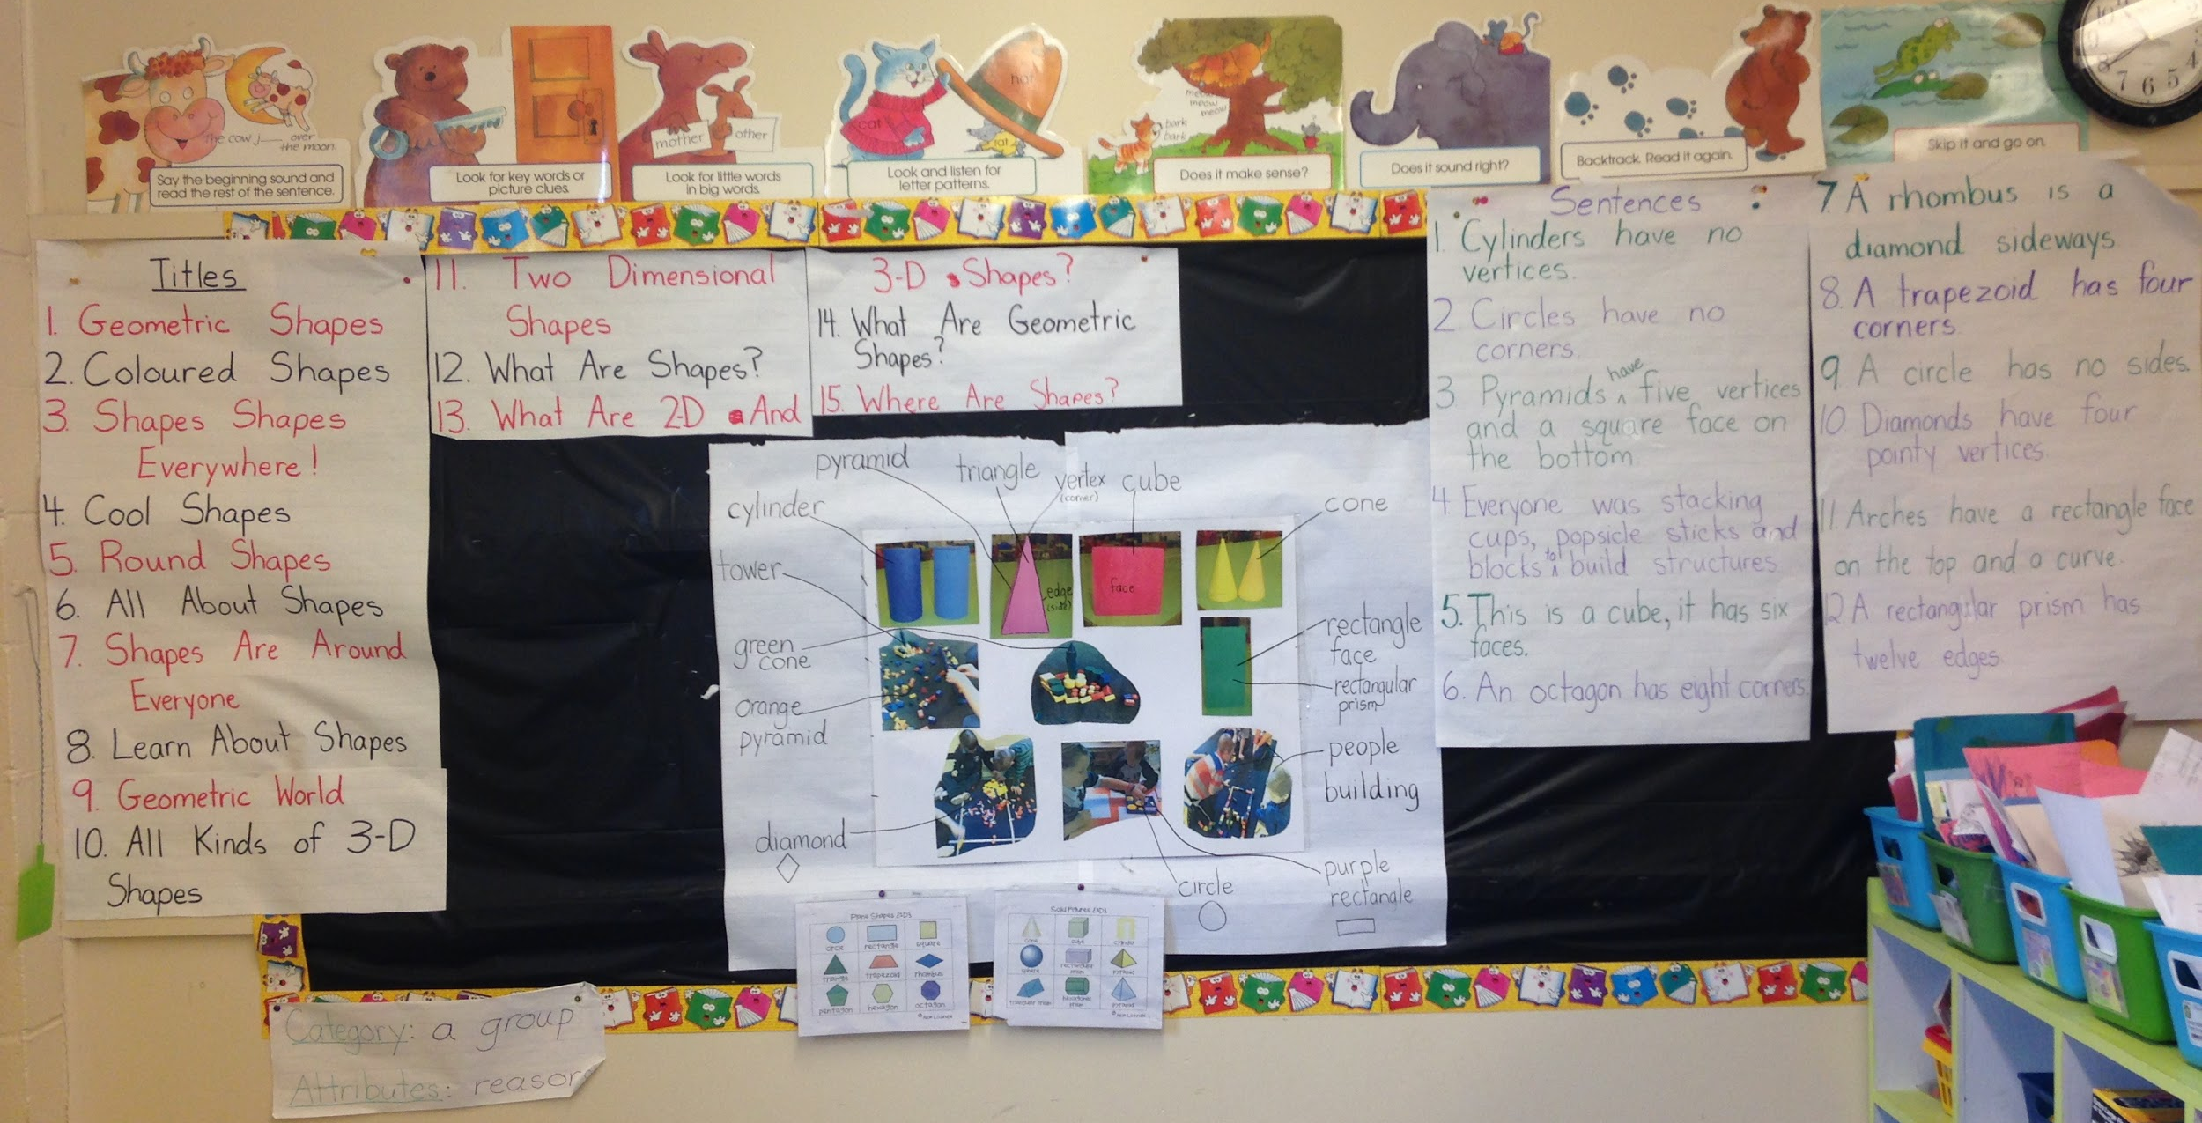
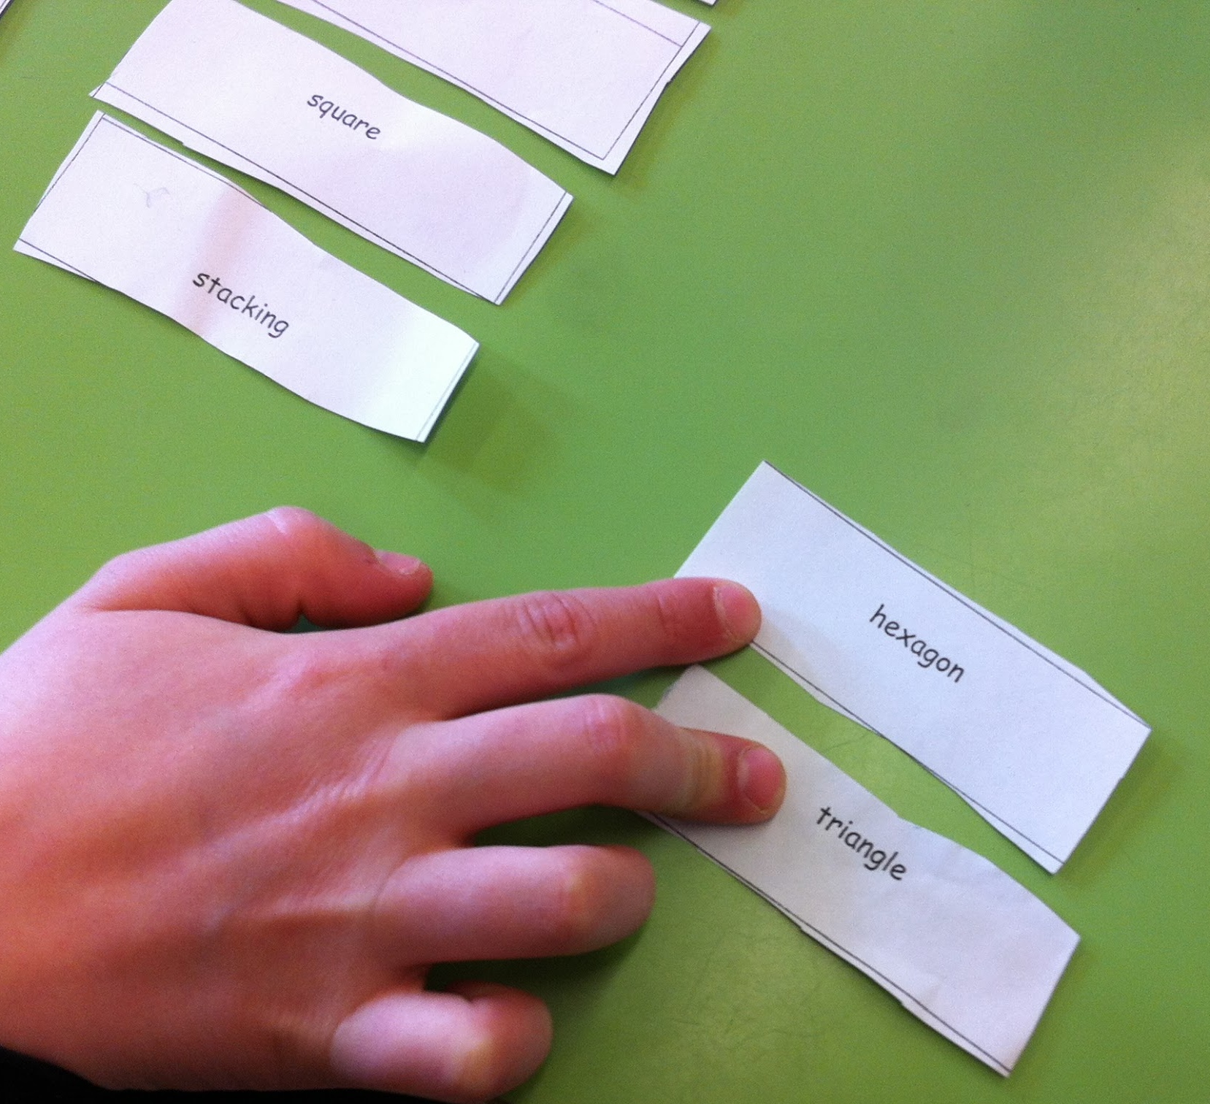
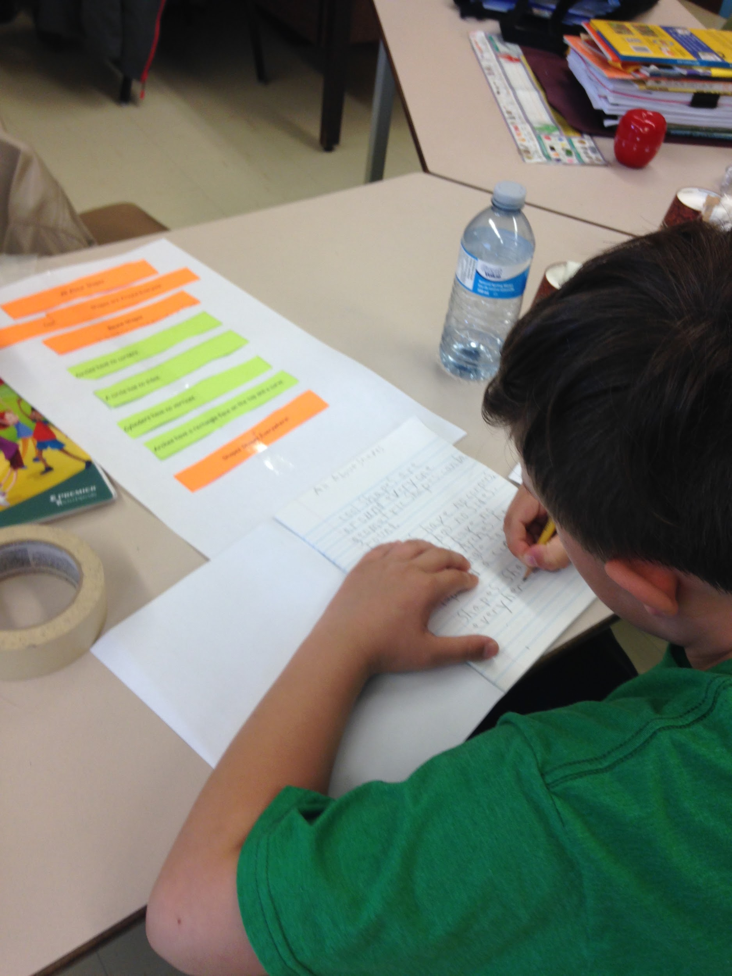
Integrating across the curriculum: reading comprehension, writing comprehension, math, science and engineering...
Picture Word Inductive Model (PWIM) Emily Calhoune
Sentencs
Making categories using structural, phonetic and contextual analysis
Titles
Vocabulary
Making meaningful connections within the curriculum through Language Arts, Math and Science
The reading and writing connection

Slide 13
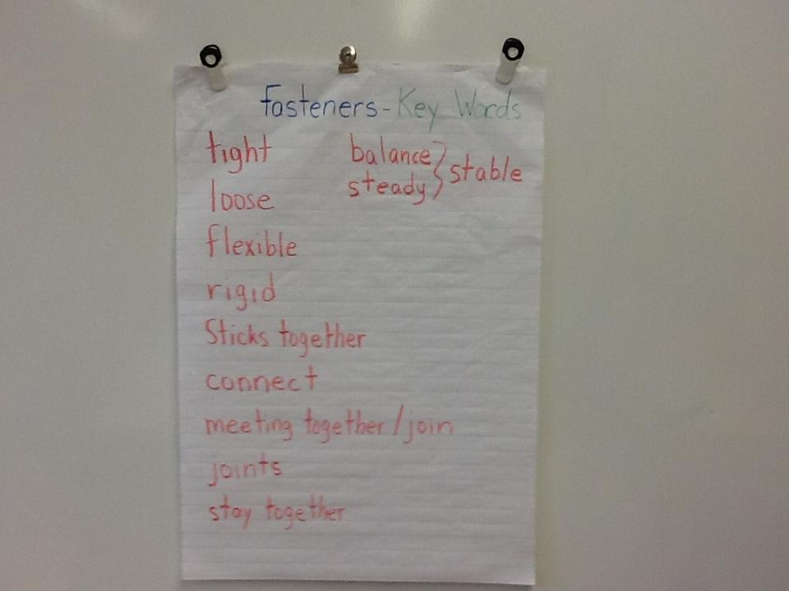
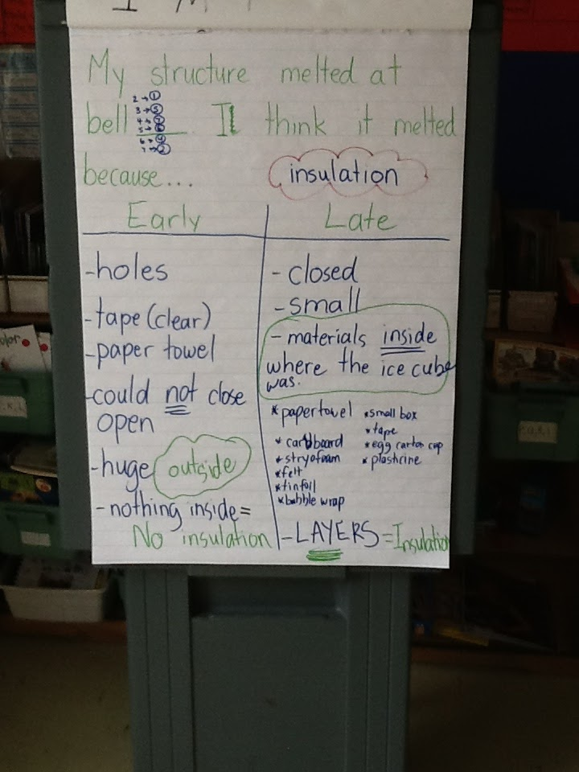
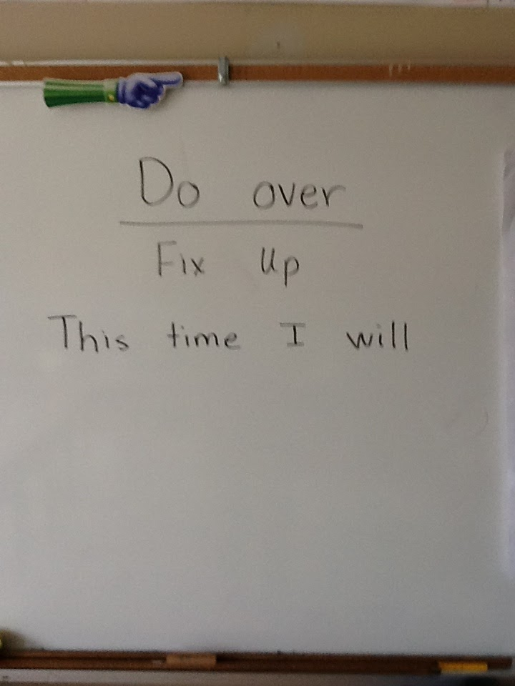
Implementation
EXPLAIN &/ ENGINEER
Teacher facilitates. Learner develops explanation or engineers the concept
Results of our MANY class discussions: work...reflect...work...

Slide 14
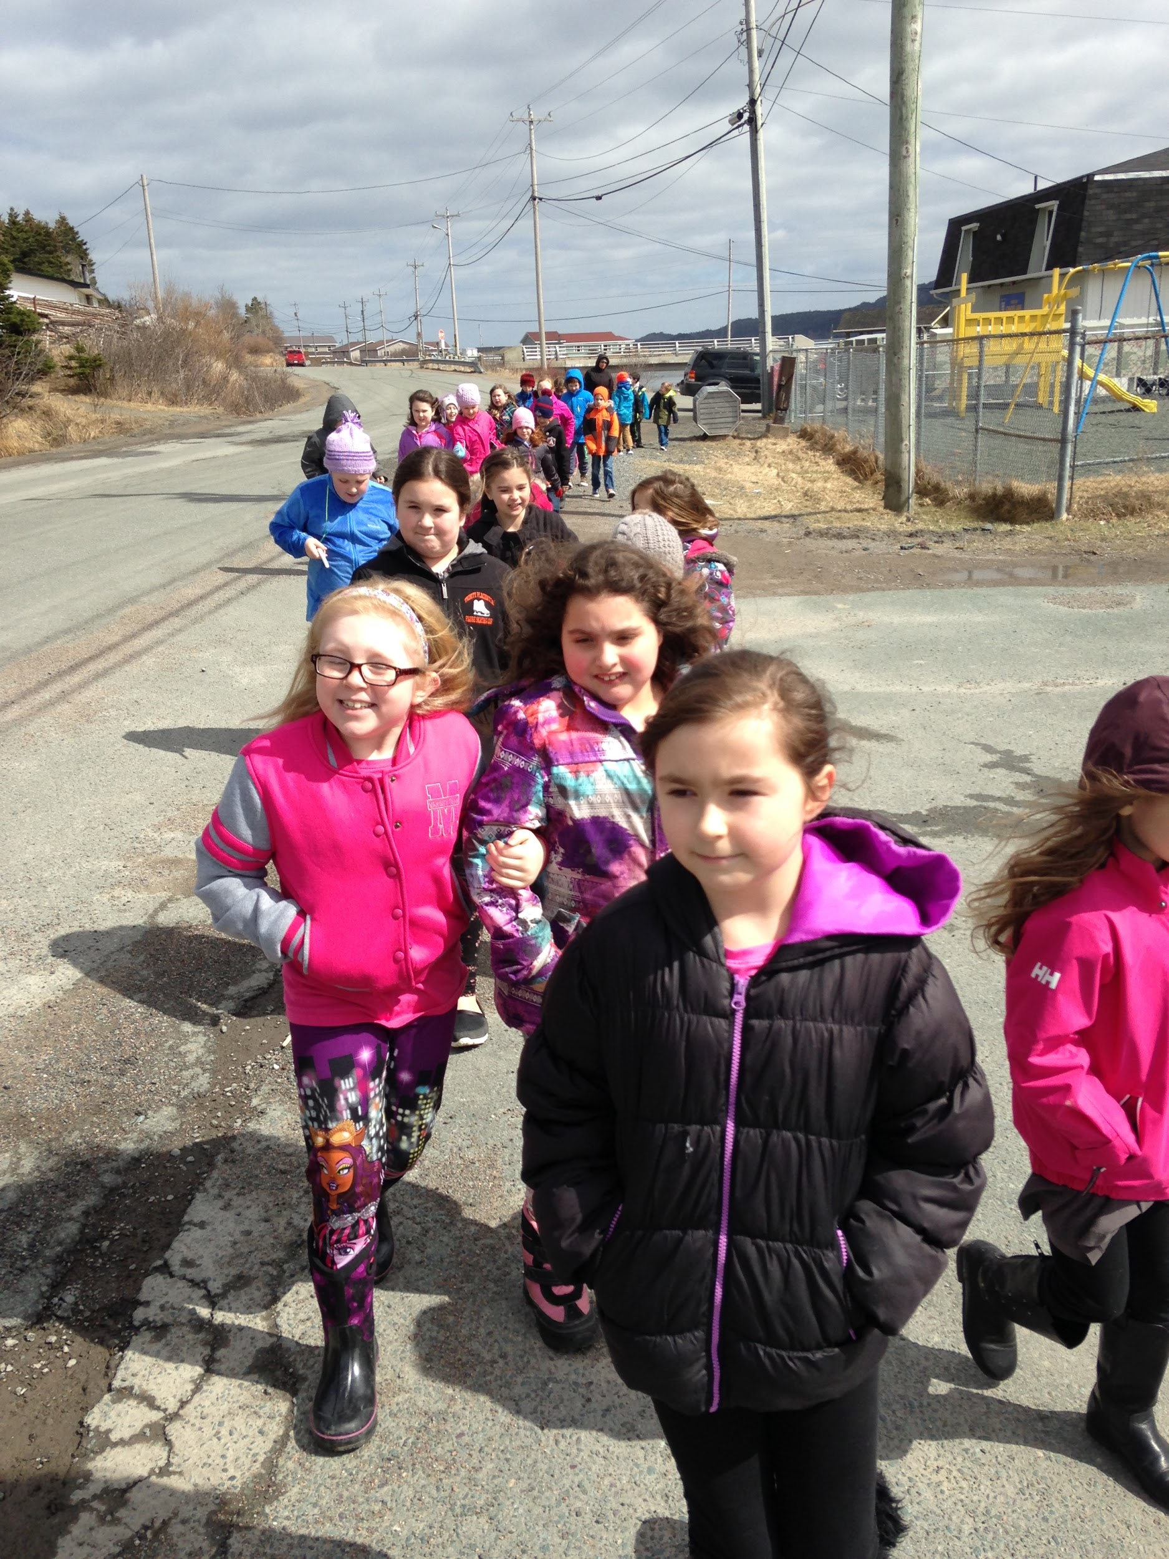
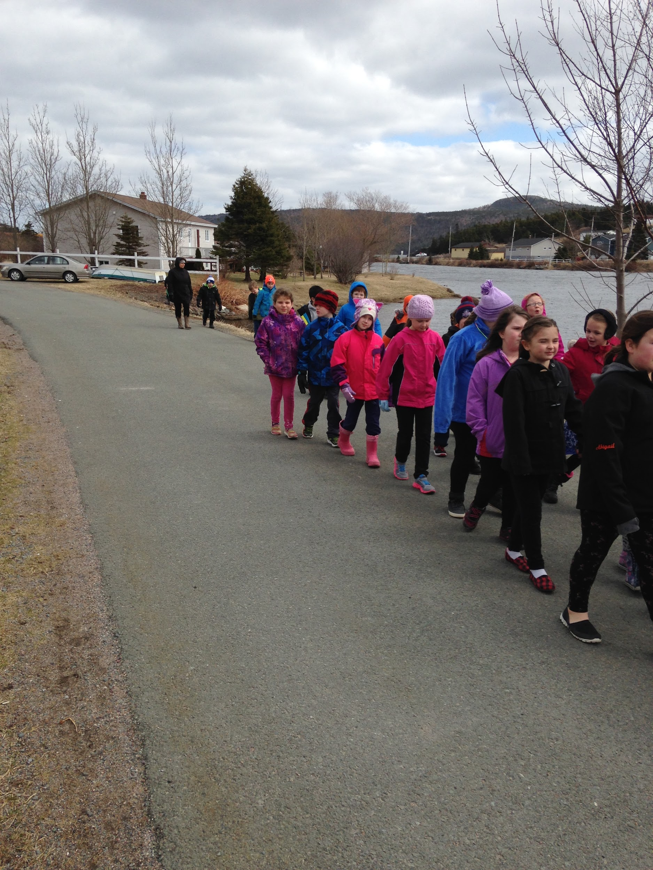
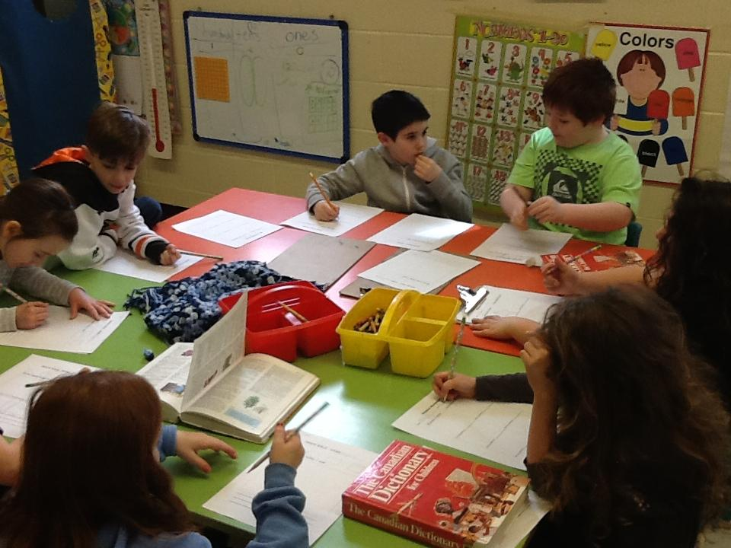
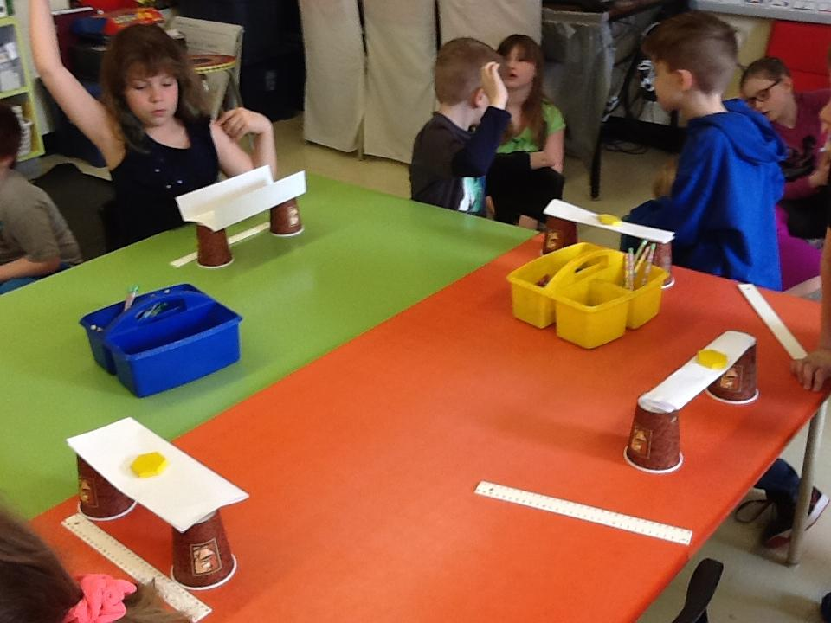
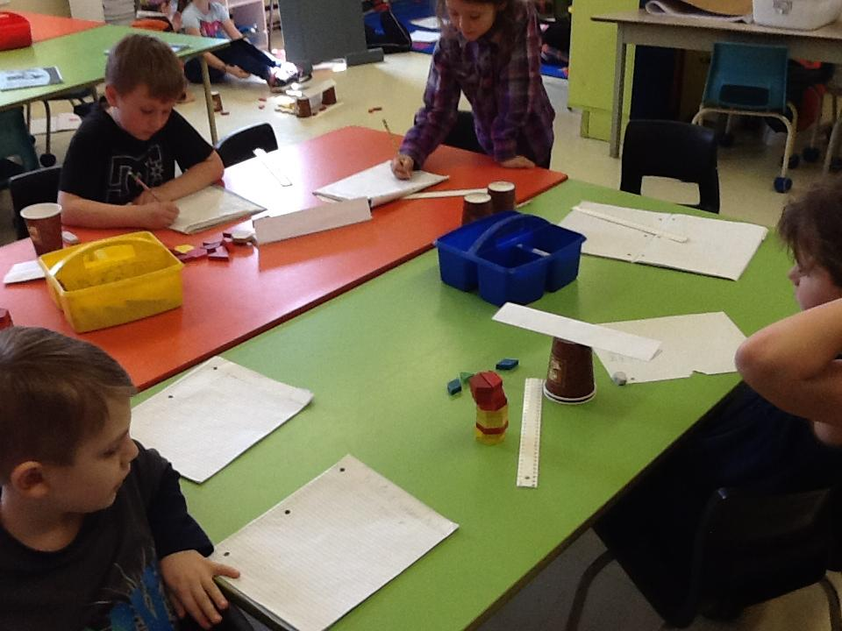
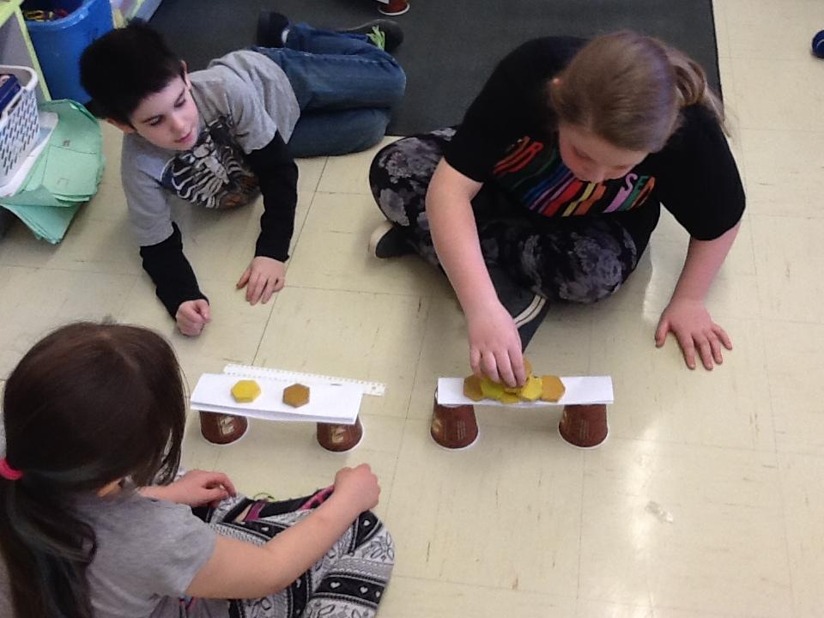
Implementation
ELABORATE
Learner applies what is learned...may modify or improve ideas

Slide 15
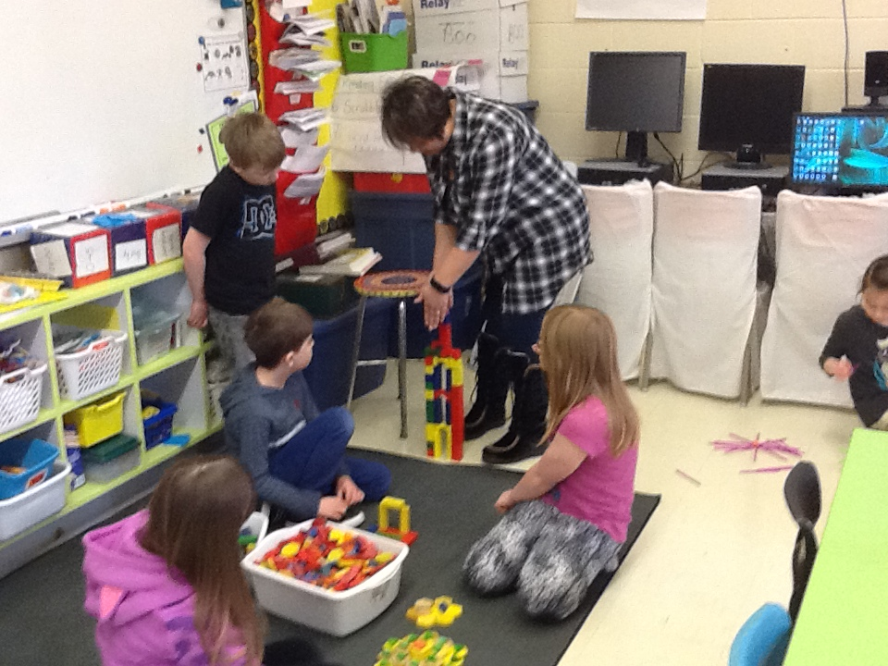
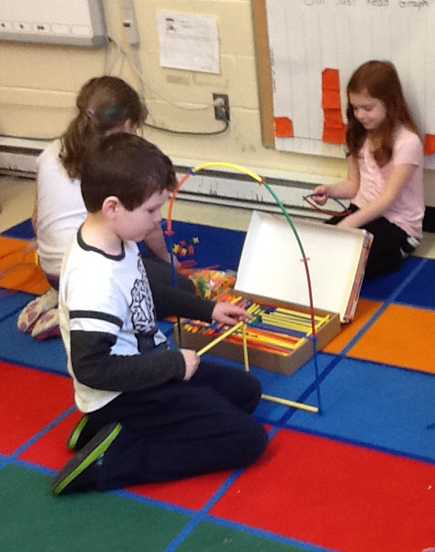
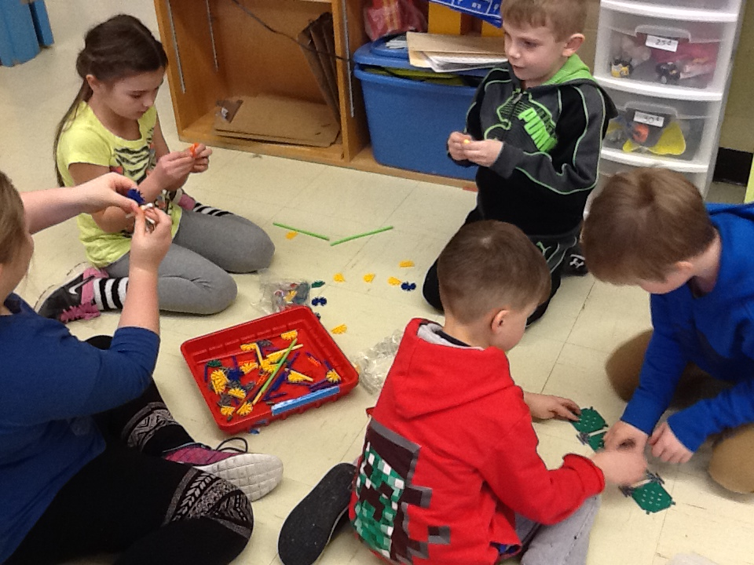
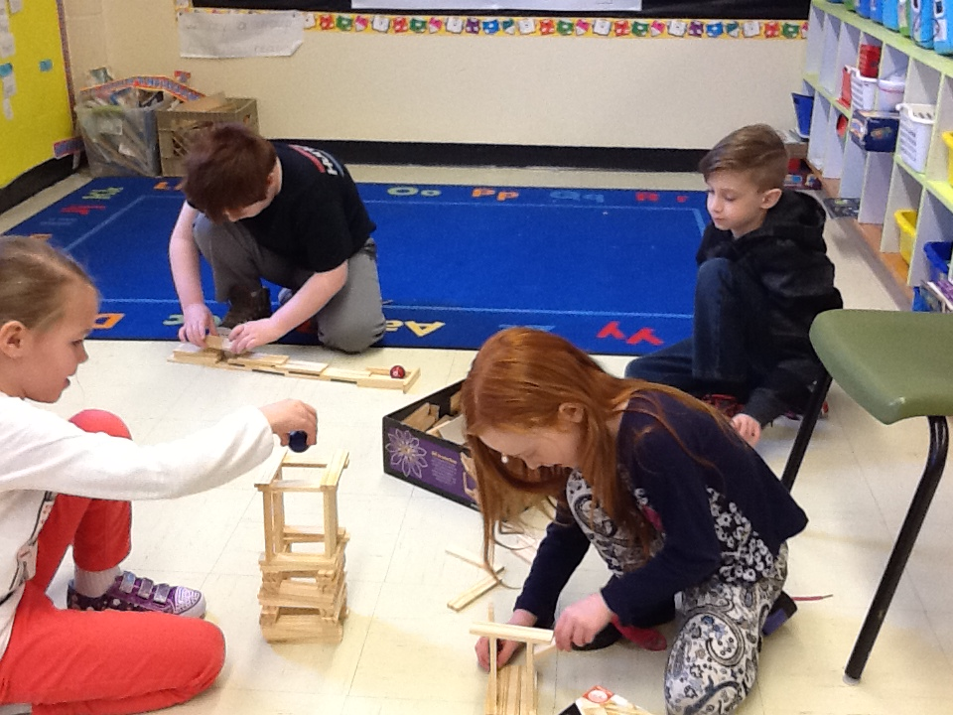
Free Exploration
The students explored the different materials for this unit. We used this opportunity to observe and interact with the students. In doing this, we were able to see what background knowledge the students had. This helped to guide our instruction.
#1
EXPLORE
Exploring concept(s)

Slide 16
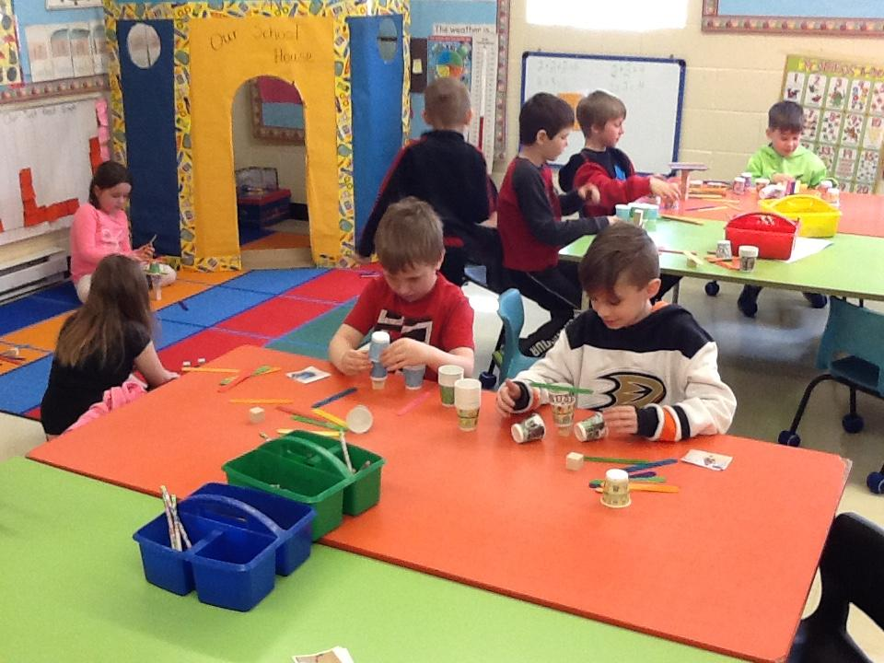
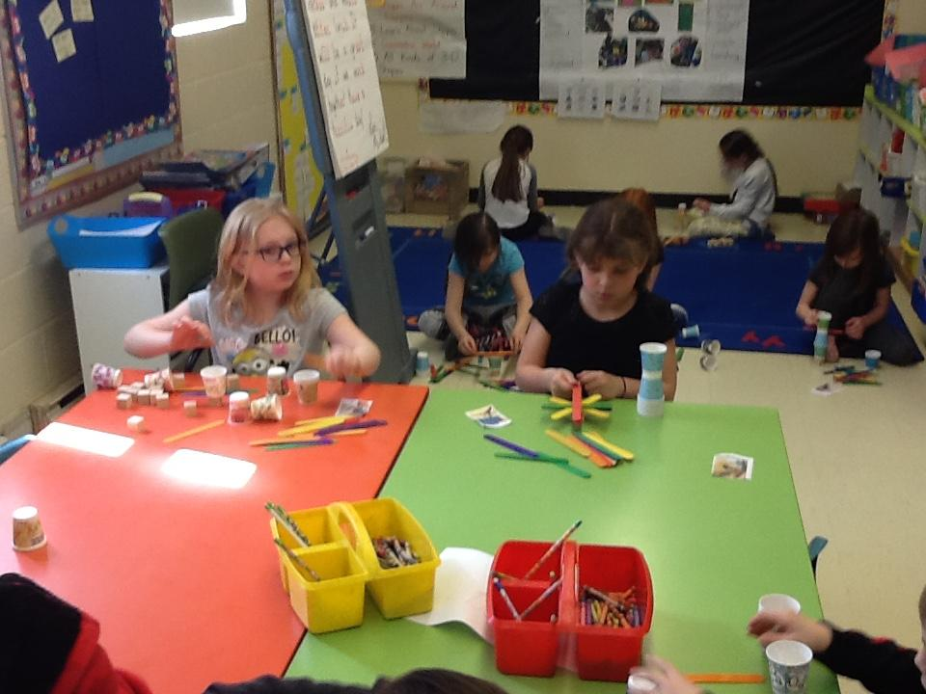
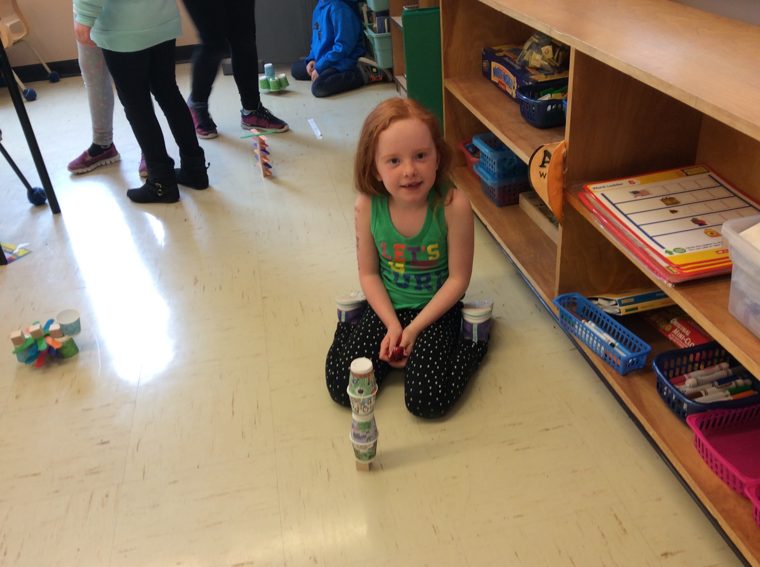
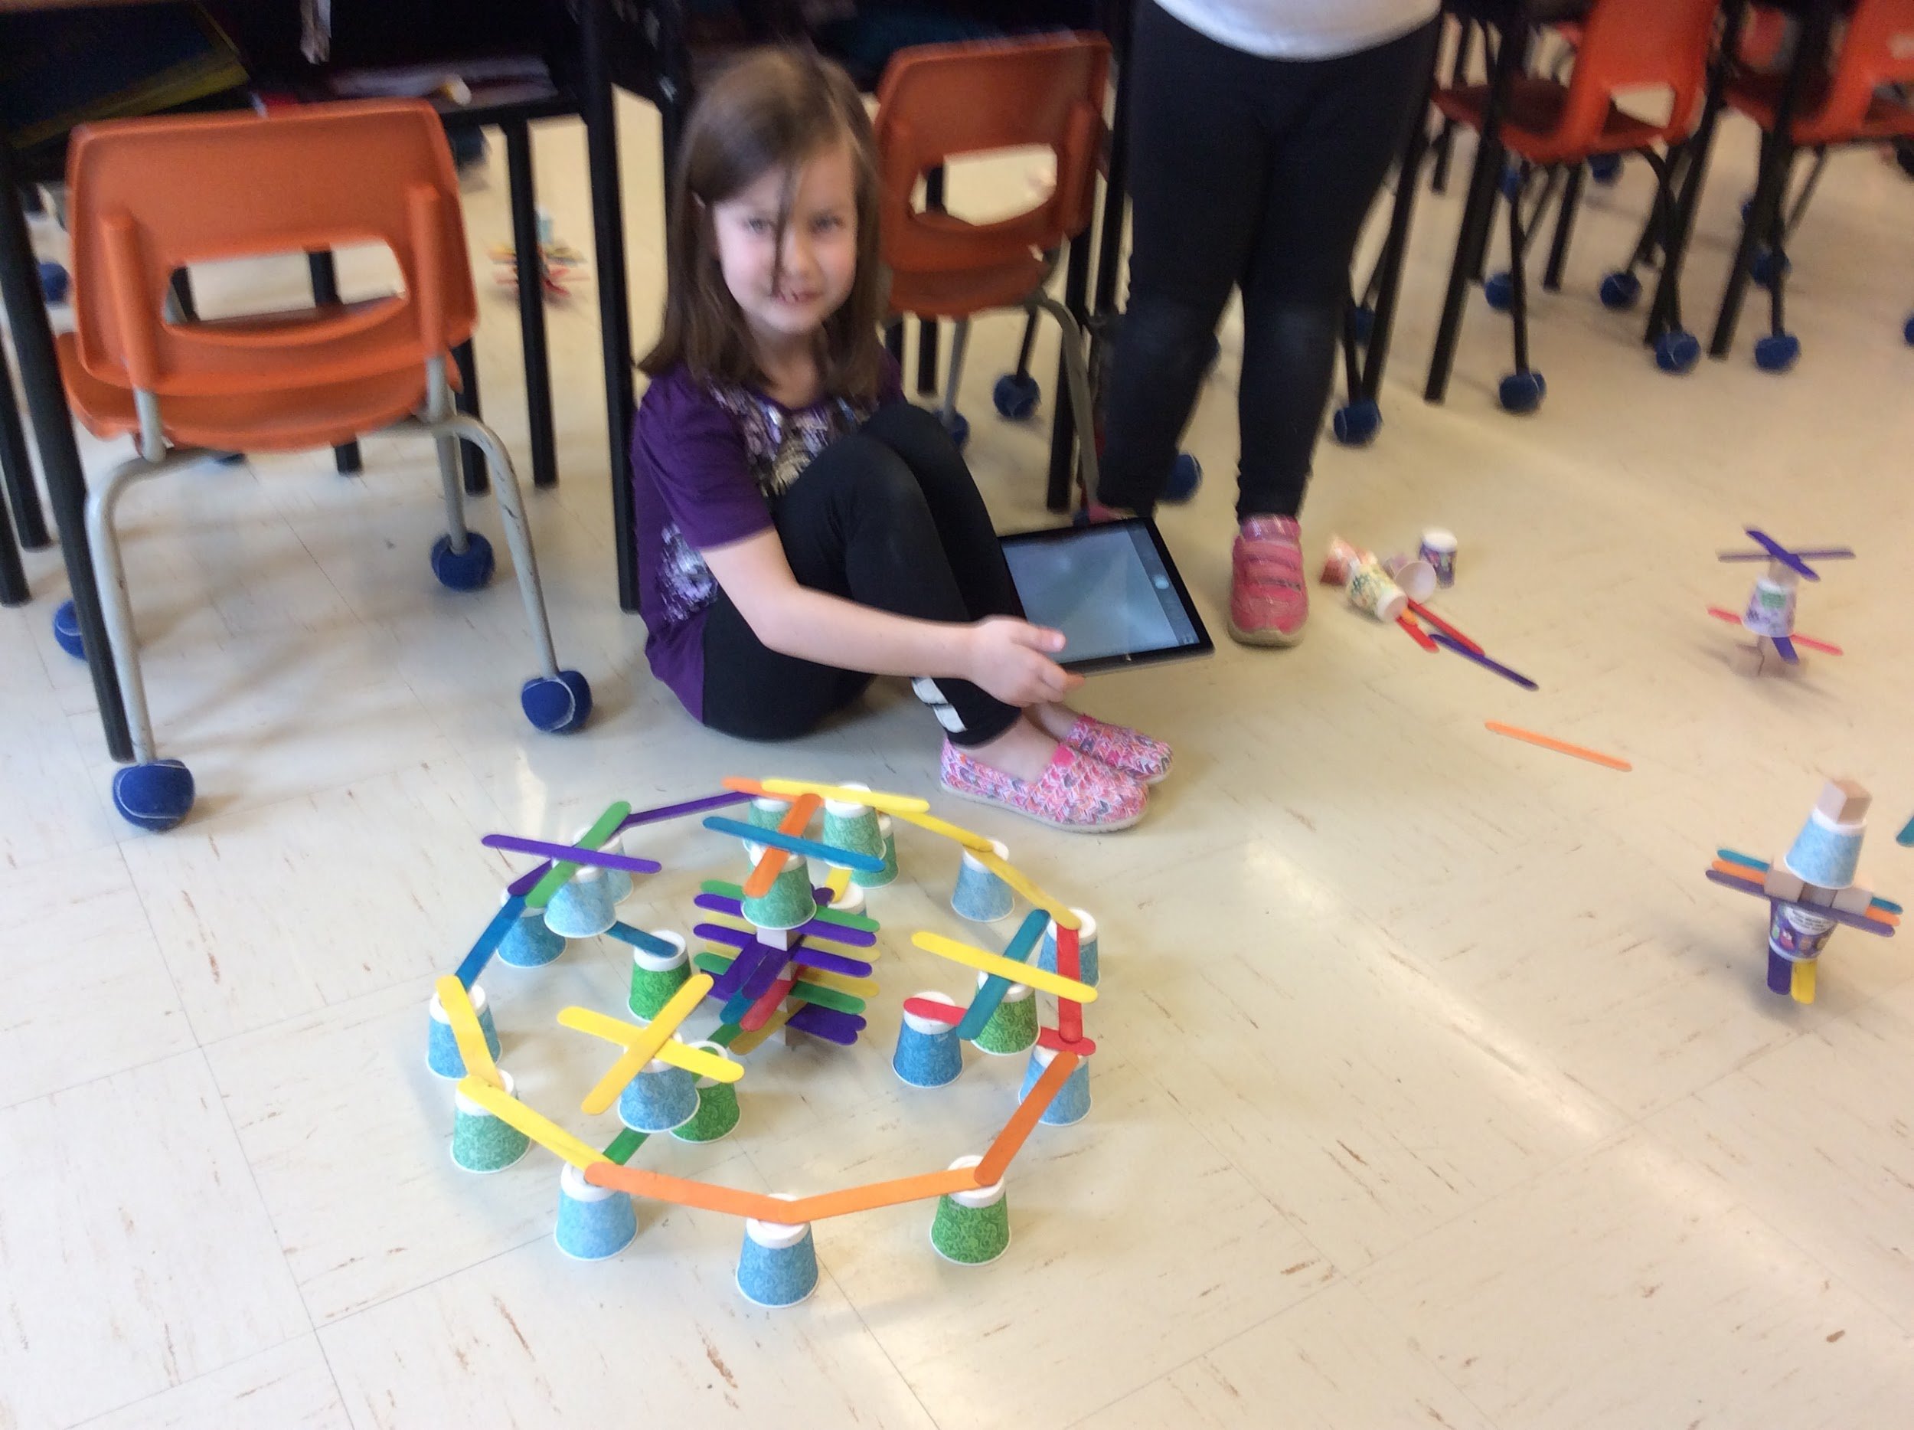
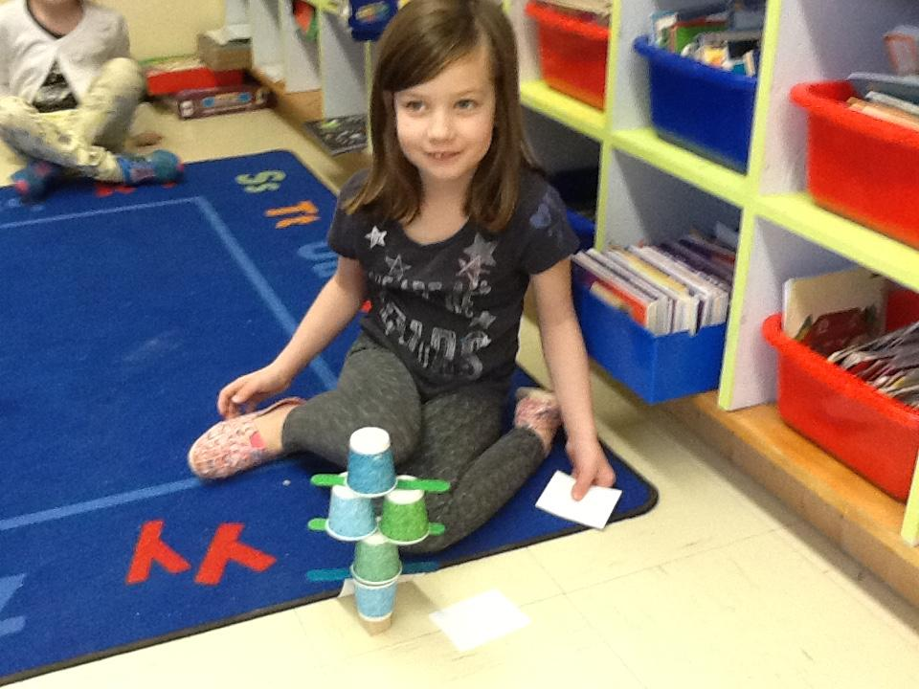
Implementation
We did many challenges!
#2
EXPLAIN &/ ENGINEER
Teacher facilitates. Learner develops explanation or engineers the concept
Students engaged in a challenge to build a structure with one cube as the base!
Notes:
Discuss: base, characteristics of a structure (chart)
****didn’t concept of base

Slide 17
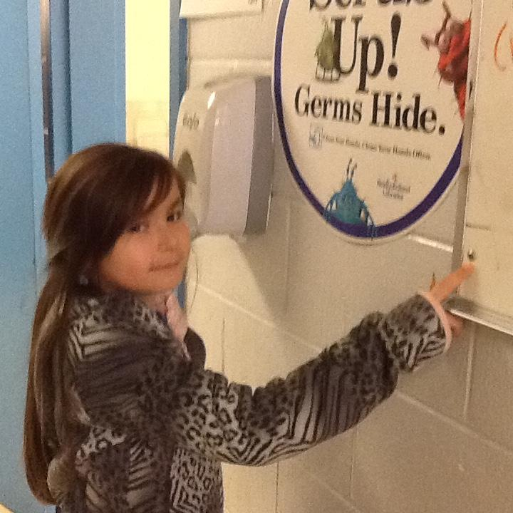
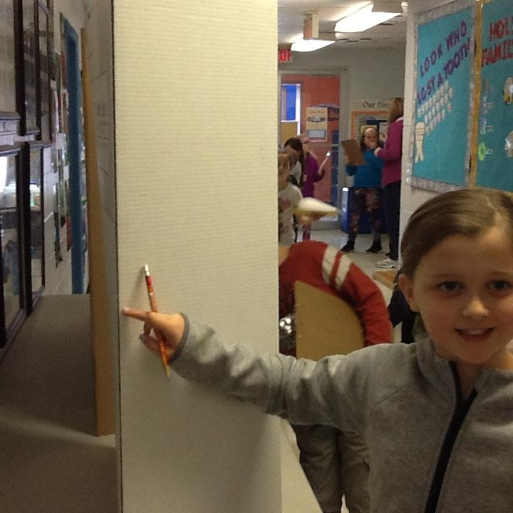
Fascinating Fasteners
Exploring RIGID & FLEXIBLE fasteners
In this challenge we looked for examples of things that were fastened together in the room. Lots of examples came up but they made the GENERALIZATION that the way they were fastened together were different. Some stayed still, some could move. This naturally led to the terms RIGID and FLEXIBLE.
#3
Flexible!
Rigid!

Slide 18
Fascinating Fasteners: Evaluation
They then were sent on a mission as ENGINEERING INVESTIGATORS! Mission: find examples of RIGID and FLEXIBLE fasteners. We took pictures and videos as our assessment piece.
Notes:
Add videos

Slide 19
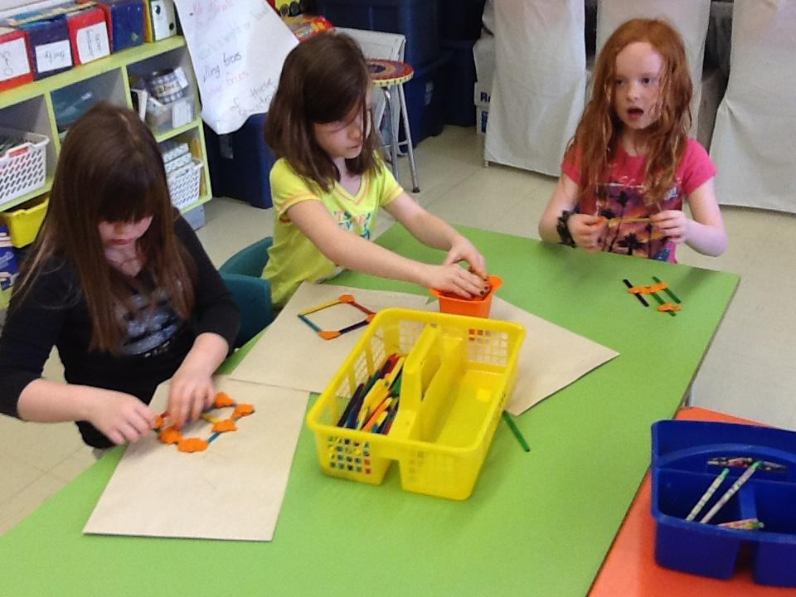
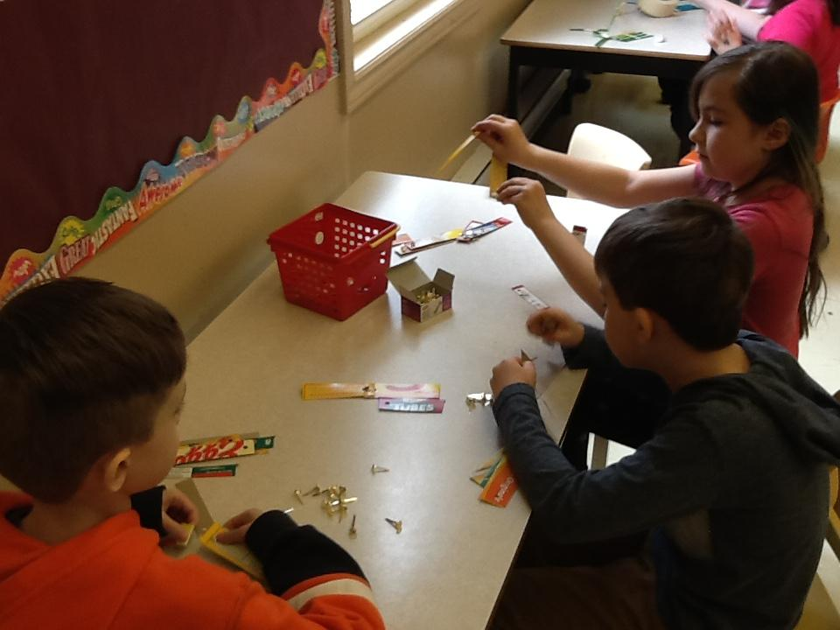
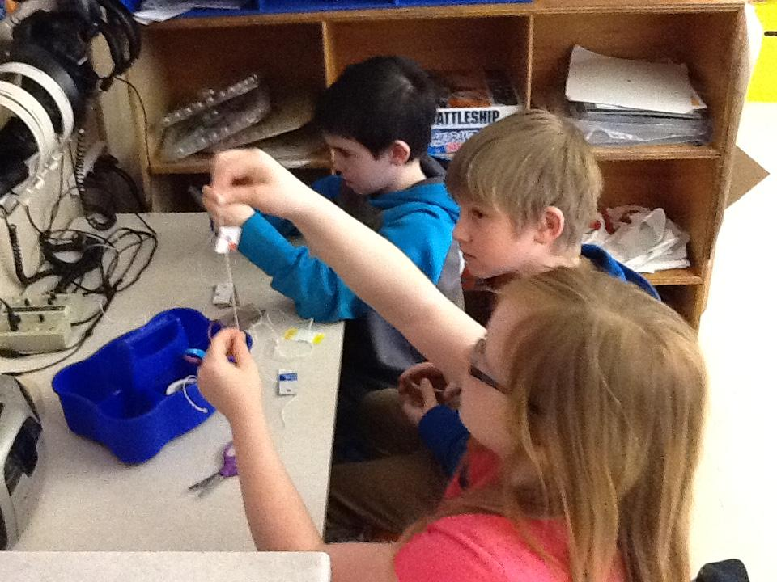
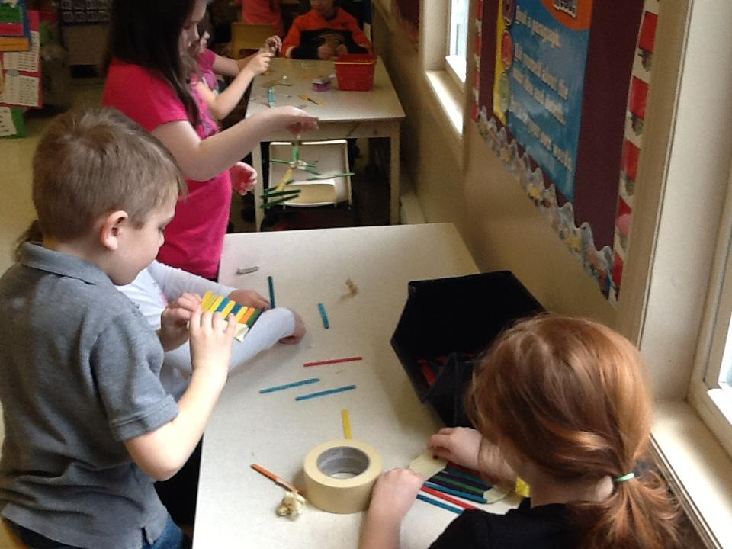
Fascinating Fasteners
Student centers
Brass fasteners
Students engaged in free exploration to explain, elaborate and evaluate different types of fasteners!! The generalizations made here would then be used in the next challenge!
plasticine
tape
string

Slide 20
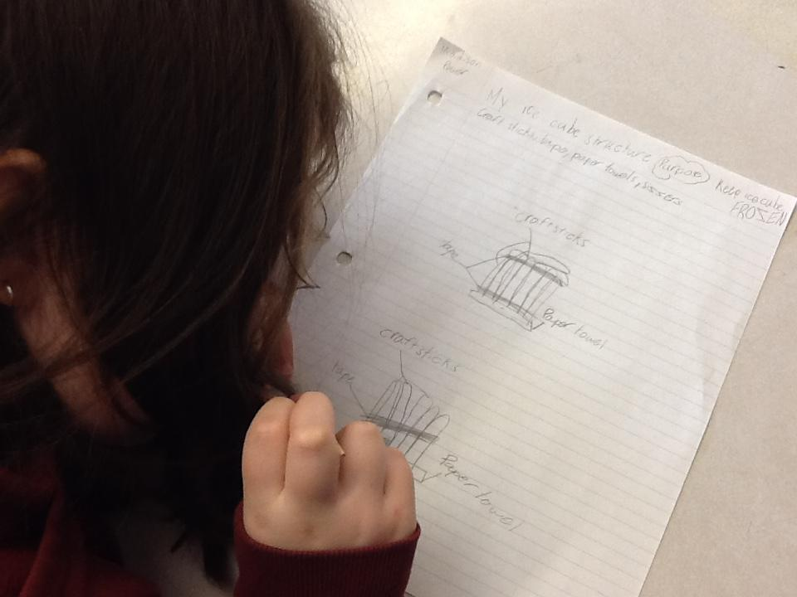
Ice Cube Structure Challenge
#4
The students made a design for their ice cube structure

Slide 21
Ice Cube Structure Challenge
The students made a design for their ice cube structure. We took many pictures and videos for reflections and evaluations
GOAL:
through this challenge we wanted students to realize that their structure was an insulator...structures have purposes!

Slide 22
Ice Cube Structure Challenge
The students made designs for their ice cube structures. They built it, then evaluated it. We then had a discussion where vocabulary NATURALLY came up. This led to a second structure which was elaboration and another evaluation! They were real INQUIRERS! We took many pictures and videos for reflections and evaluations
EVALUATE
Not just about teacher assessment. Mostly about learners evaluating their understanding

Slide 23
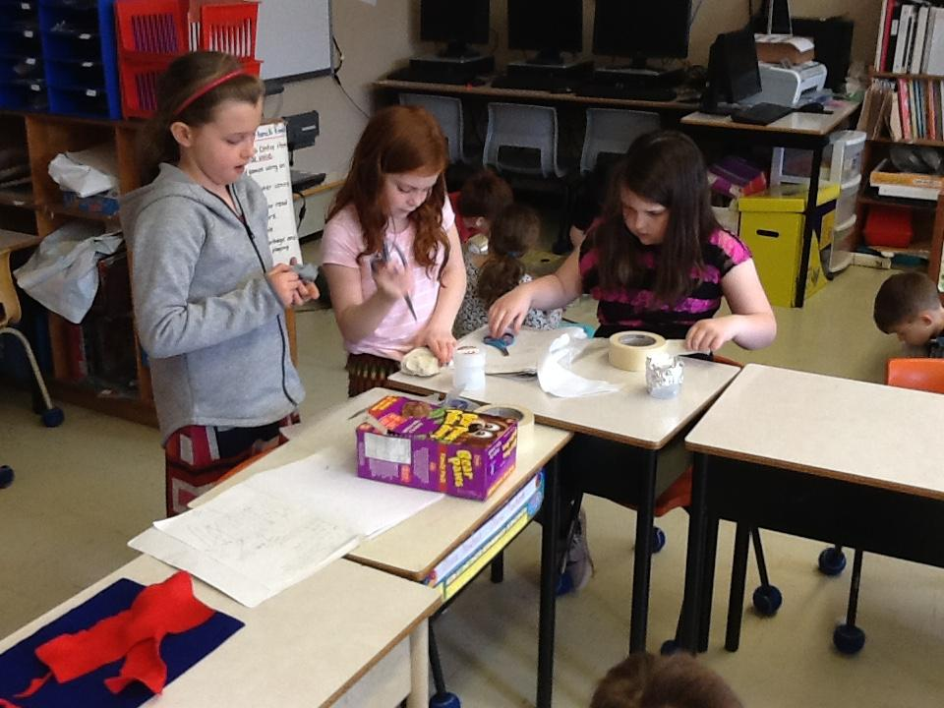
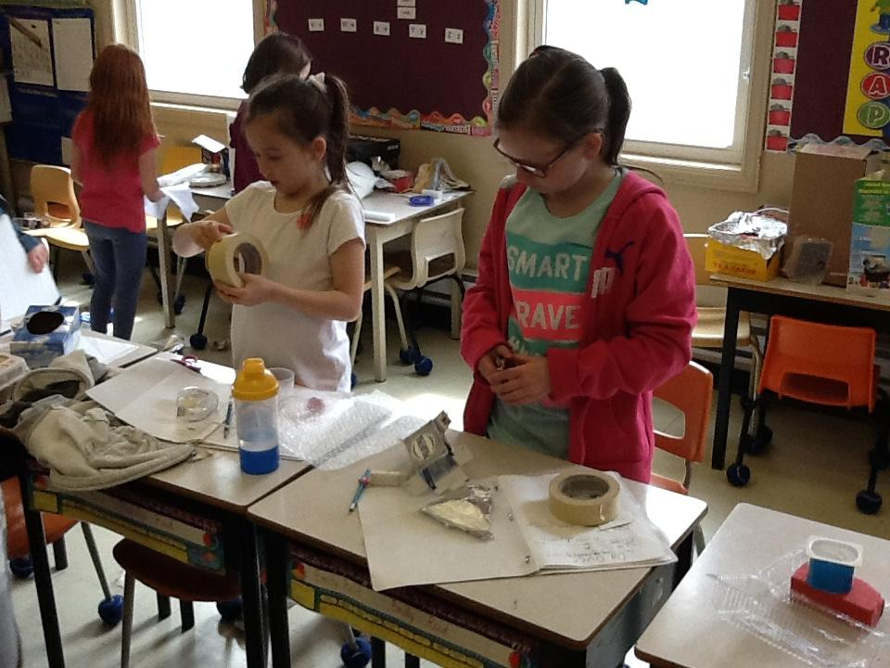
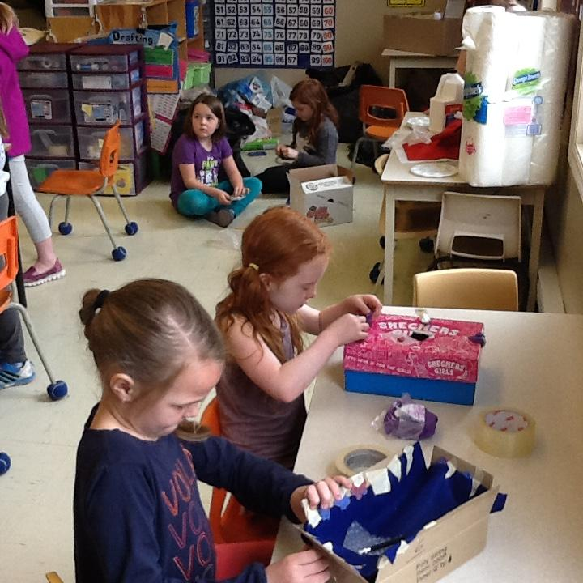
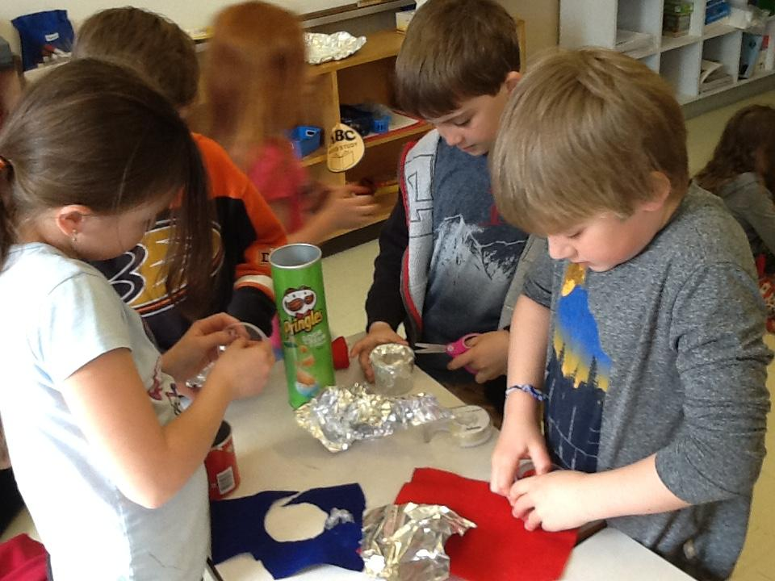
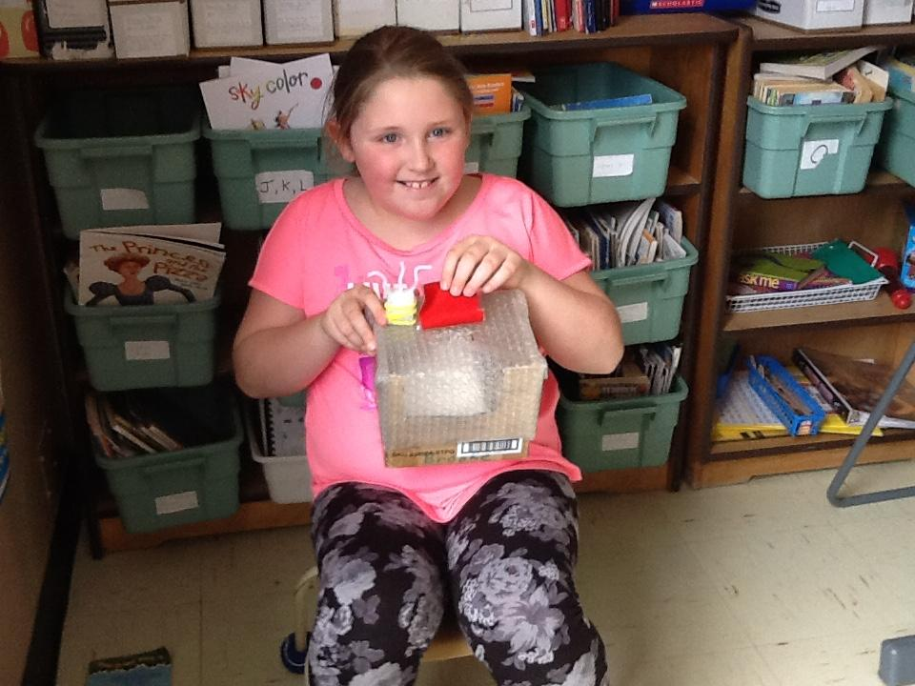
Ice Cube Challenge: evaluate...elaborate...evaluate!

Slide 24
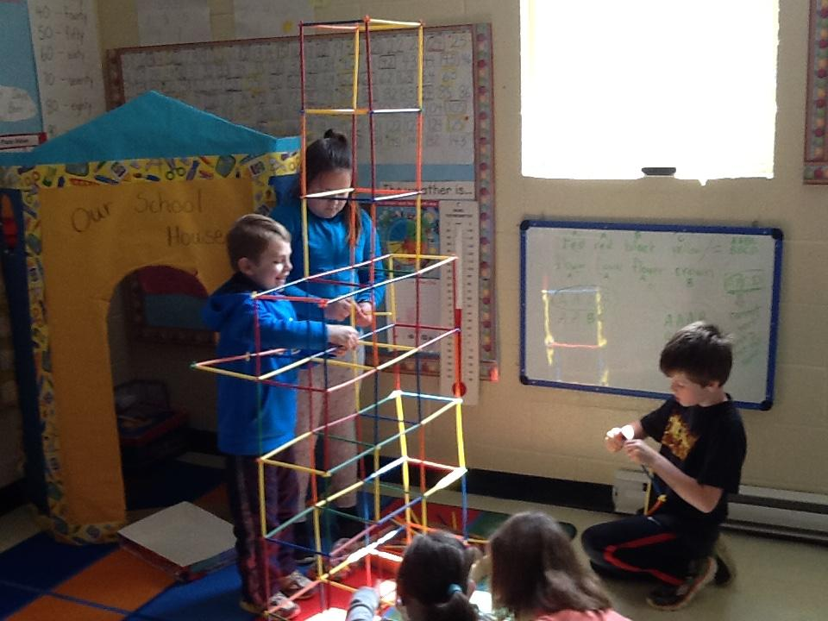
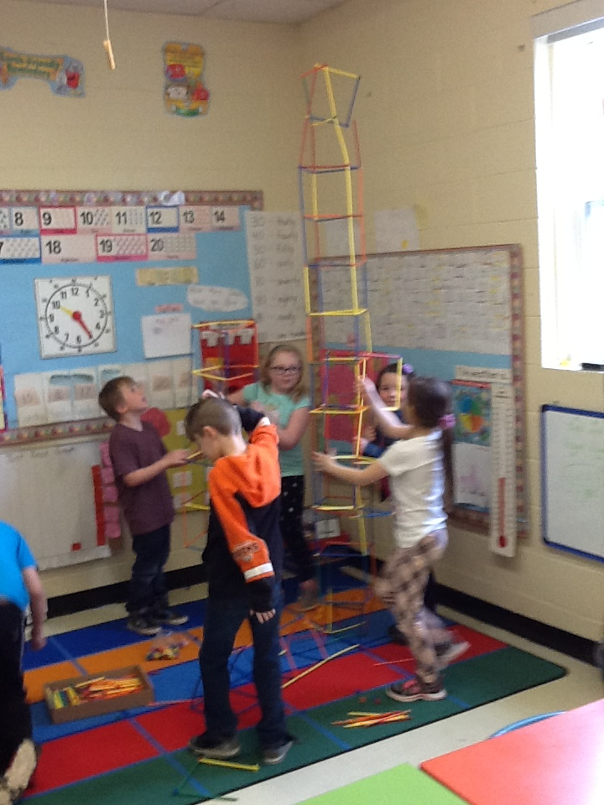
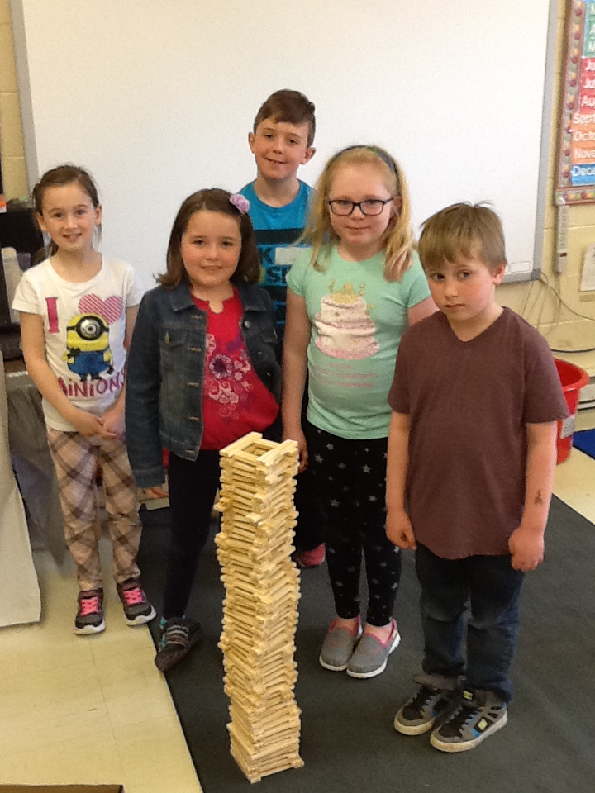
Tallest tower challenge: build the tallest, strongest tower!
#5

Slide 25
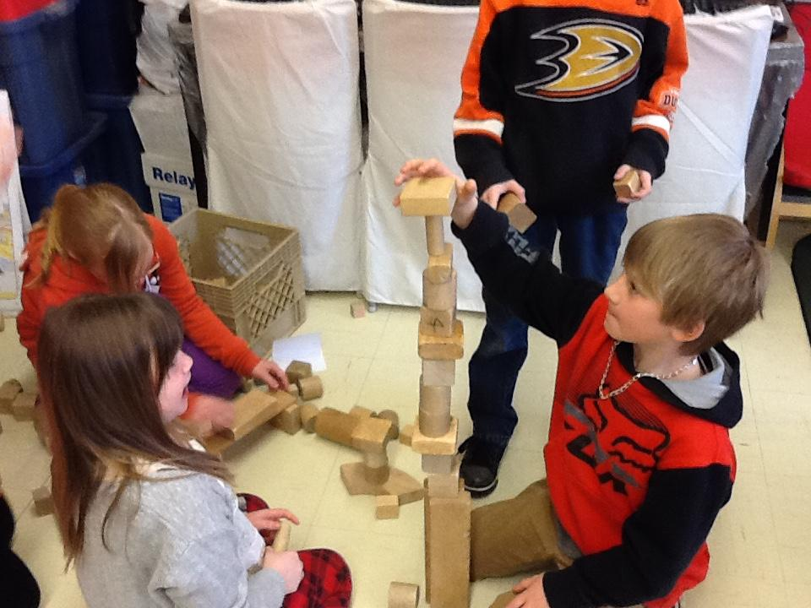
Tallest Towers...SUCCESS!!!
A cup tower as TALL as them!
23 books stacked on a paper cylinder!!

Slide 26
Building Bridges: students had to design and build a bridge that could hold a load...
#6
FOCUS
FOCUS

Slide 27
Building Bridges
EVALUATE!!
ELABORATE!!

Slide 28
BRICKS FOR KIDZ! For the unit end project, we decided to involve the ENTIRE school! The school got involved with STEM activities from this organization for an ENTIRE day! Lots of fun with science, engineering, math…
ENGAGED
ENGINEERING

Slide 29
BRICKS FOR KIDZ! For the unit end project, we decided to involve the ENTIRE school! The school got involved with STEM activities from this organization for an ENTIRE day! Lots of fun with science, engineering, math…
SUCCESS!

Slide 30
Data was collected through:
student folders and science Logs, interviews, observations, work samples, videos and photographs.
Teachers collaborated and shared information with students and parents through ClassDojo

Slide 31
Data Collection and Analysis
We used Student Surveys (pre and post). They answered questions then drew a picture of Science Class.
Notes:
Discuss didn’t like it

Slide 32
Survey Results
1. Do you like Science?
In October--- 93% said yes ----- 7% said no
In May ---- 93% said yes ----- 7% said no
2. My teacher encourages me to ask questions?
In October--- 89% said yes -----11% said no
In May ---- 96% said yes ----- 4% said no
4. In Science I like to:
a) Work alone ---- October 25% May ---- 29%
b) Work in a group -- October 11% May ---- 25%
c) Both ----- October 64% May ---- 46%
3. Students completed the sentence: "Science is fun when...."
Most responses in October included:
*when we do experiments *we write and play games *we look at soil and touch it to see how it feels *we go outside *we play with dirt *we feel things
Two students said Science was not fun.
Most responses in May included:
*we build structures and test them *we work in centers

Slide 33
Survey Results
5. Students were asked to draw a picture of their Science class.
Results in October:
Most pictures were of students at tables/desks discussing with teacher at front, as well pictures of students working together in groups at tables doing experiments.
Results in May:
Most pictures were of students scattered around the classroom (in groups and individually) --- on the floor, at desks, at tables, in the hallway. They are engaged in designing and building structures. The teachers are also scattered around talking with them, taking pictures and videos.

Slide 34
Findings
5. Students were asked to draw a picture of their Science class.
Results in October:
Most pictures were of students at tables/desks discussing with teacher at front, as well pictures of students working together in groups at tables doing experiments.
Results in May:
Most pictures were of students scattered around the classroom (in groups and individually) --- on the floor, at desks, at tables, in the hallway. They are engaged in designing and building structures. The teachers are also scattered around talking with them, taking pictures and videos.

Slide 35
Teacher Inquiry - our growth...
Formative Assessment
Our assessment was ongoing on a DAILY basis as the students went through the EDP-5E model. This directed our instruction daily.
EDP-5E Model
As teachers we realized that we were engaged in this model just as much as the students were.
Facilitators
We became working partners with the children.

Slide 36
Special Thanks To...
Thomas Walsh
Professor Karen Goodnough, Ph. D
Craig Adams
Memorial University Of Newfoundland
Hibernia Management and Development Company Ltd. (HMDC)
BRICKS 4 Kidz- Kelly Noseworthy
Holy Family Elementary School- Administration and Staff
Students and Families

